Slide 1
Infor Vendor Management System (VMS) Worker Training
Dale Menefee
Sr. Delivery Partner Manager
3rd Party Management Office
Notes:
Welcome to the Vendor Management System Overview Training Course; commonly referred to as VMS
The goal of this module is to introduce you to the general operations and terms used in the VMS

Slide 2
Objectives
At the end of this session you will understand:
VMS Time & Expense process flow
VMS Time & Expense Roles and Responsibilities
How to process enter Time and Expense transactions in VMS
Notes:
At the end of the module you will be able to:
Identify the relationship between Beeline, Infor, Suppliers, and Subcontractors
Understand Infor’s Vendor Management System also know as VMS
Understand the various VMS Roles and Responsibilities, and
Understand the basic VMS Workflow

Slide 3
INFOR Vendor Management System Supplier and Worker Training
Supplier Training | Worker Training
Monday Oct 23, 2:00 PM
 | Tuesday Oct 24, 10:00 AM
Wednesday Oct 25, 10:00 AM
Wednesday Oct 25, 6:00 PM
 | Thursday Oct 26, 7:00 AM
Friday Oct 27 7:00 AM | Friday Oct 27, 3:00 PM
‘Supplier’ training is full Supplier IVMS functionality, and includes Time & Expense entry
‘Worker’ training is for billing consultants; resources whose only interaction with IVMS will be to enter T&E
If a person attends Supplier training they will not need to also attend Worker training

Slide 4
VMS Project Timeline
Task | Deadline
System QA & User Acceptance Testing | Current through early November
Weekly Supplier touchbase calls | Through go-live
Collection of contract Addendums and initial profile PROD upload data | Through November
“Blackout” period | Mon Nov 20 – Fri Dec 01
Supplier and Worker Training | Mon Oct 23 – Fri Oct 27
Go-Live: System opened to user access | Mon Dec 04
T&E entry: For T&E incurred through Nov 30 For Fri Dec 01 For week of Dec 02 – Dec 08 | Processed with current system ASAP beginning Monday Dec 04 By Saturday Dec 09, which begins the regular VMS weekly cycle

Slide 5
Understanding the Vendor Management System

Slide 6
Understanding the Vendor Management System
Vendor Management System – commonly referred to as a VMS
It is a system designed for the procurement and management of subcontractors
Beeline is the VMS that Infor Services has implemented
Beeline and Infor have configured the VMS according to Infor’s business needs
The VMS will be used by all subcontract labor Suppliers, their Workers, and Infor
The VMS will be the only means to procure and pay for a subcontractor
Notes:
Infor’s Vendor Management System or VMS is Beeline’s product that was created to streamline the process of hiring temporary workers.
It automates the process of procuring, managing and analyzing contingent and project based labor
The VMS is a cloud based system that is offered as a service from Beeline.
Beeline has worked with Infor to configure the VMS in a manner that best suits our business needs.
Infor, our Partners and Sub-Contracts will all be users of the system
This system will be the sole mechanism to procure and pay 3rd Party Resources utilized by Infor Services.

Slide 7
Vendor Management System Overview
Requisition creation & distribution to suppliers
Real time reporting and analytics
Resource profile
Interview, Acceptance
Invoicing
On/Off Boarding
Performance Metrics
Time and expenses
Notes:
For a high level overview of the VMS system: Starting at the top of the diagram:
Role requests, whether being passed from Polaris or being entered directly into Beeline for those areas not supported by Resource Management, begin the process
A request is then sent to the Suppliers, who will then submit candidates to begin the process of reviewing profiles, interviewing and candidate selection
Once a Candidate is selected, they will be on-boarded and the Request becomes an Assignment
The Candidate will enter their Time and Expenses into the VMS, and this is also where the PM will approve or reject the Time and Expenses.
The VMS will provide various Performance Metrics necessary to run our business
Supplier Invoicing will be done based on approved time and expense within the VMS
The VMS will provide Real Time Reporting and Analytics
I am now going to show you two sample screens from Beeline

Slide 8
VMS Roles - Supplier
Supplier (Manager) – Supplier is the term for a subcontract labor provider. Also referred to as vendor or partner. Some of the functions of the Supplier Manager in VMS include:
Adding Resource Profiles
Submitting Resource Profiles to requests
Accept/Reject Offers
Approve/Reject Amendments/Extensions
Worker also referred to as Resource – this is a billing consultant. A Worker has access to only one area in Infor VMS: Time and Expense entry
Notes:
The Supplier is an organization that provides Sub-Contractors to Infor. A Supplier can be a Partner, Consulting or Staffing Company that has been provided access to the VMS by Infor and has an established sub-contracting agreement with Infor. Suppliers are also referred to as Vendors or Partners. The Supplier uses the VMS to Add Resource Profiles, Submit Candidates to Requests, accept or reject offers by Infor to engage a Candidate and approve or reject amendments or extensions.
Subcontractors are individuals who accept assignments on a contingent or contractual basis. They will use VMS to enter their time and expenses against the projects and tasks that have been set up for them.

Slide 9
Additional VMS Terms
Work Order: Record in VMS of accepted, committed subcontract work with start/end dates, pay rate, project details, named Supplier and Worker, etc. Time and Expenses are reported against the Work Order in VMS.
Extension: Modification to a Work Order that changes the start or end dates without changing the budget
Amendment: Modification to a Work Order that changes the budget, e.g. adding hours

Slide 10
VMS Workflow

Slide 11
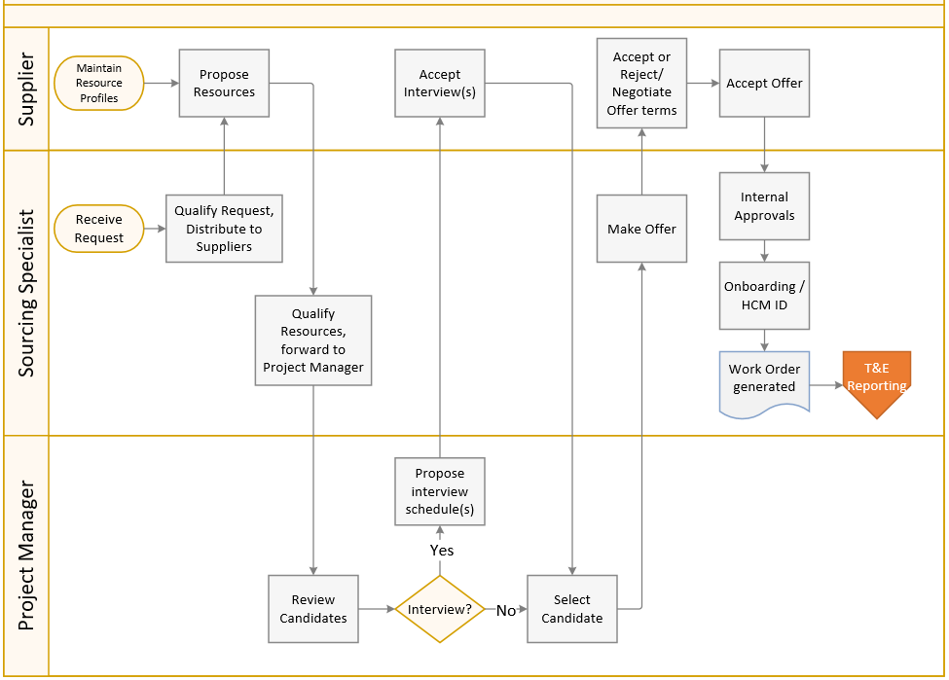
VMS Workflow – Request through WO generation

Slide 12
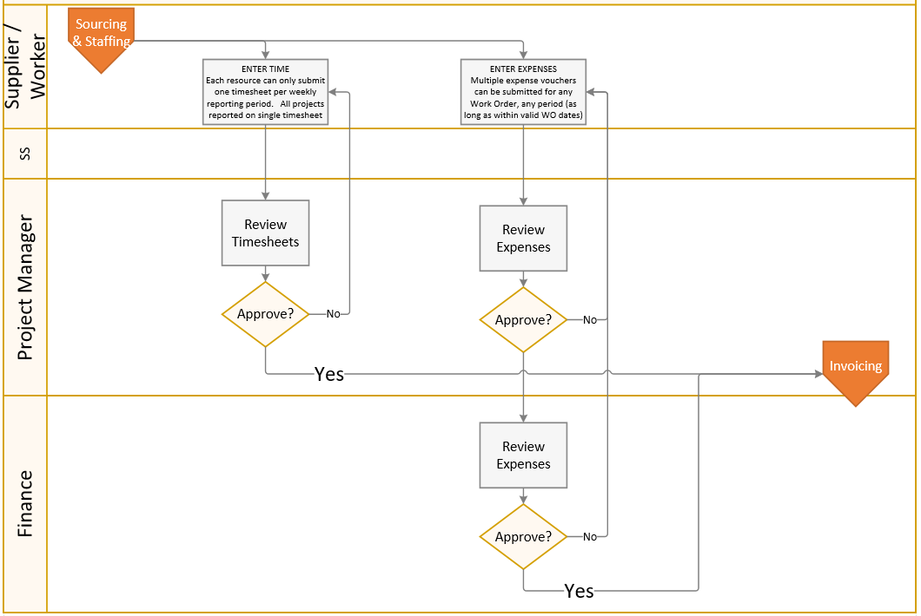
VMS Workflow – Time & Expense Reporting

Slide 13
Time and Expense

Slide 14
Timesheet and Expense Reporting Guidelines
When entering Timesheets and Expenses, all Clarity tasks will be presented for selections. The user must be careful to only select a Labor task for Timesheet entry, or an Expense task for Expenses
Timesheet
Only one Timesheet per Worker per week can be entered.
Includes all hours worked on all projects/all tasks by that Worker during that period.
Expenses
Multiple expense vouchers can be entered for any day, any Work Order. Not time period dependent
Expense vouchers can have multiple items (e.g., airfare, hotel, meal) on one voucher
Only one Work Order per voucher
Weekly Process Schedule
T&E submission by Saturday midnight Eastern time
PM approval by the following Tuesday
Invoice run Thursday, payment per terms

Slide 15
Time and Expenses – Timesheet

Slide 16
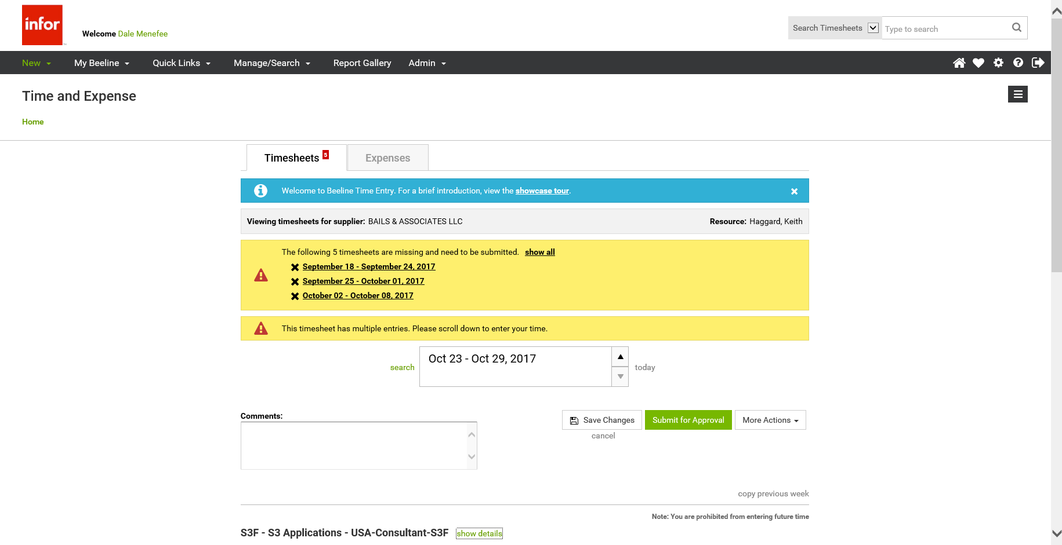
Time and Expense Entry
Top half of Timesheet screen
Toggle between Timesheets and Expenses
Showcase tour recommended for new users
Missing Timesheets (for this Worker)
3 oldest are displayed
Can Display All missing timesheets (for this Worker)
Can scroll to display timesheets for other reporting periods
Timesheet currently being displayed
Save or Submit

Slide 17
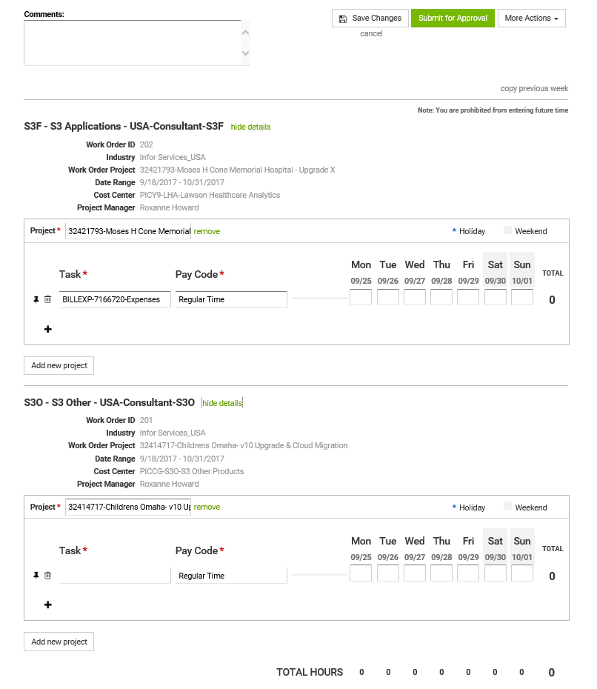
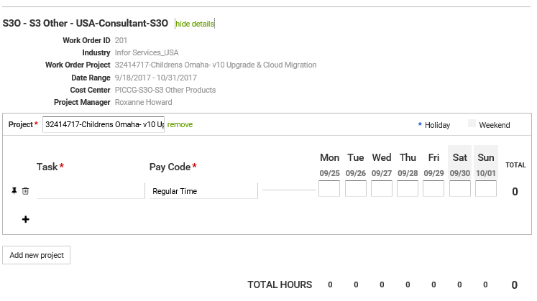
Time and Expense Entry
Lower half of Timesheet screen
WO details
Clarity project
All valid Work Orders
for this Worker
for this period
Select Task
Enter Time

Slide 18
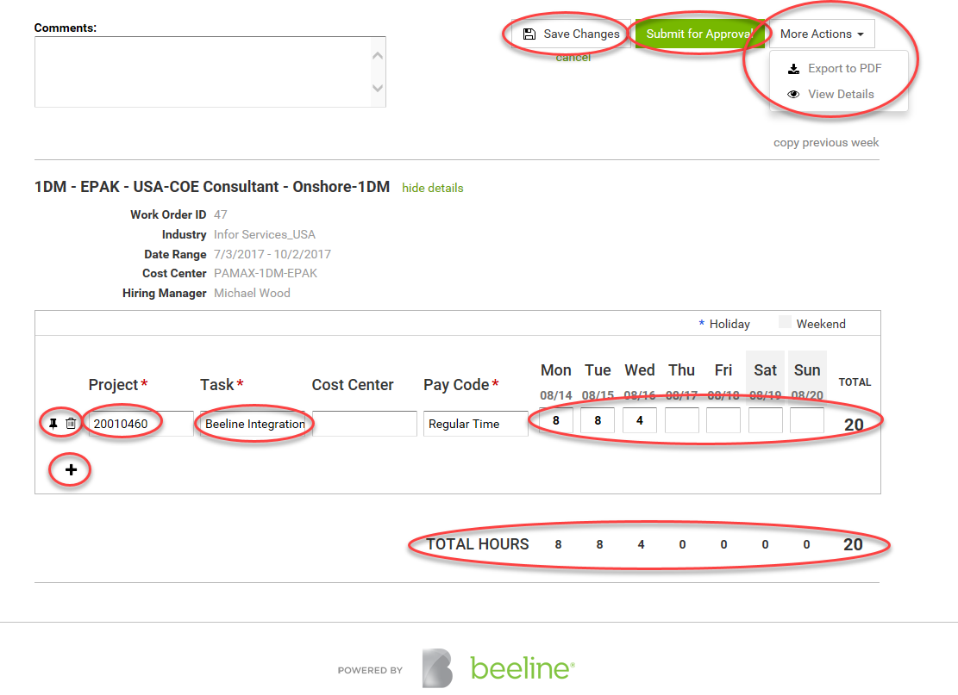
Enter Time / Enter Expense - Timesheet
Must pick a non Expense task !!

Slide 19
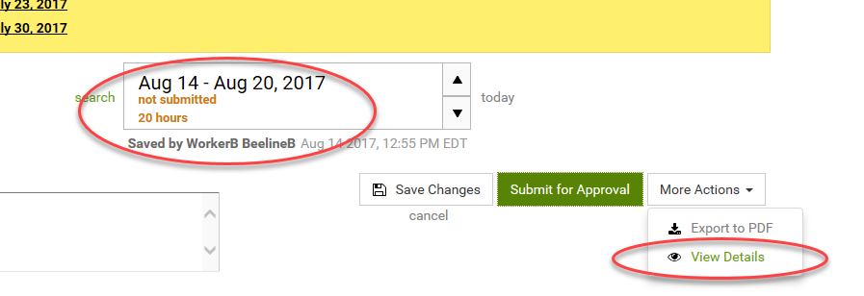
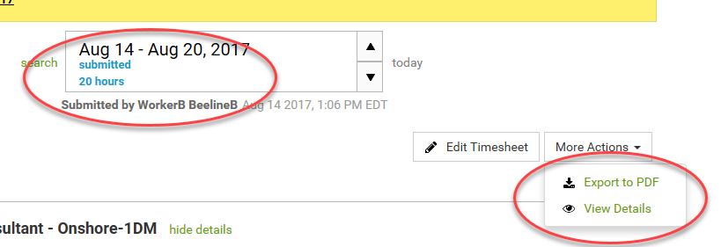
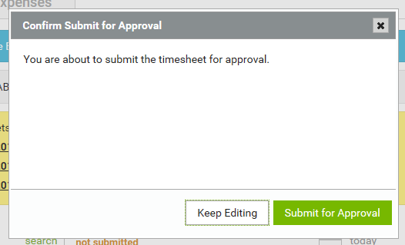
Enter Time / Enter Expense - Timesheet
Save timesheet
Submit timesheet

Slide 20
Time and Expenses – Expenses

Slide 21
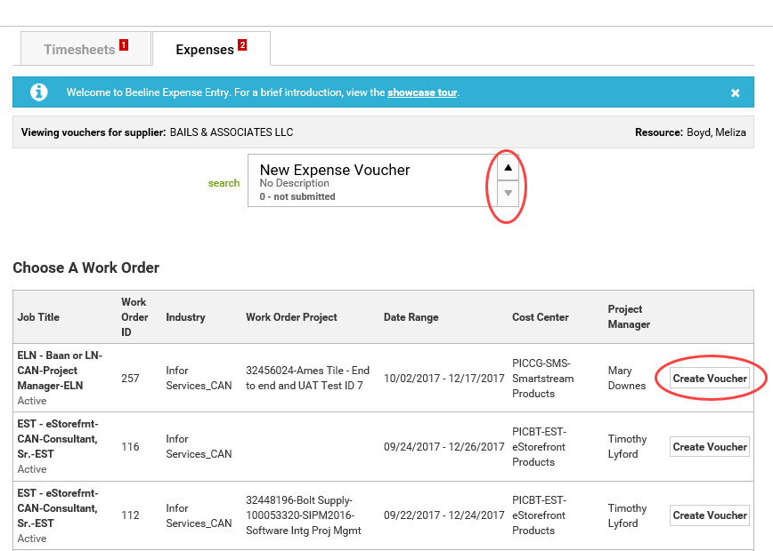
Enter Time / Enter Expense - Create/Edit Expense Voucher
Scroll to previously created voucher
or
Presented with valid WOs, select ‘Create Voucher’

Slide 22
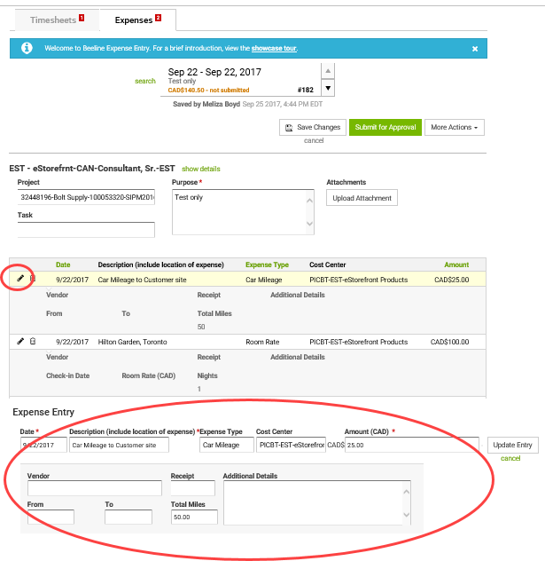
Enter Time / Enter Expense - Edit existing Expense Voucher
Click on pencil icon to edit
Current details appear for editing

Slide 23
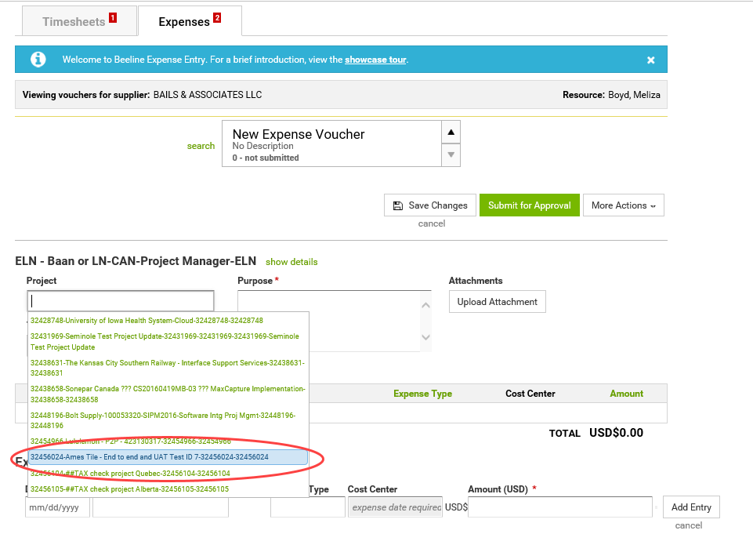
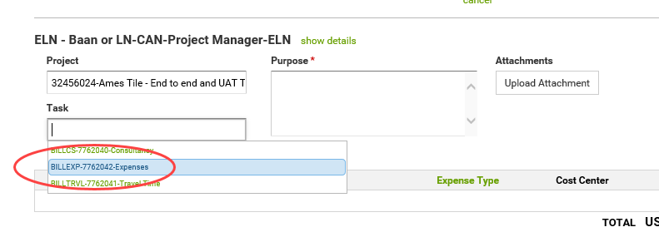
Enter Time / Enter Expense - Enter new Expense Voucher
Must re-select correct Project
Then must select Expenses task

Slide 24
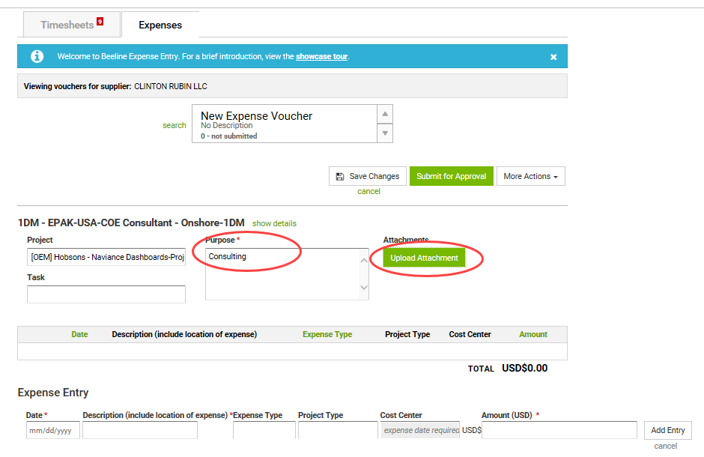
Enter Time / Enter Expense - Enter new Expense Voucher
Must pick an Expense task !
“Amount” is in currency of WO
Do any conversions prior to entry
Arnie

Slide 25
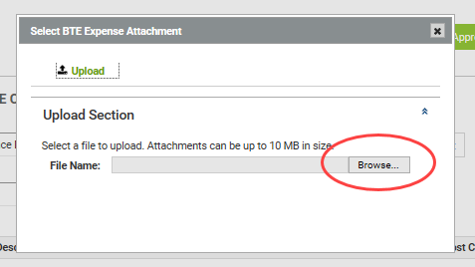
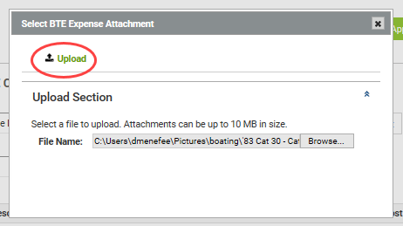
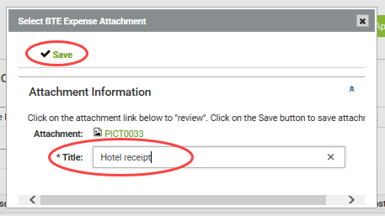
Enter Time / Enter Expense - Expenses Adding Attachment
“Amount” is in currency of WO
Do any conversions prior to entry
Arnie

Slide 26
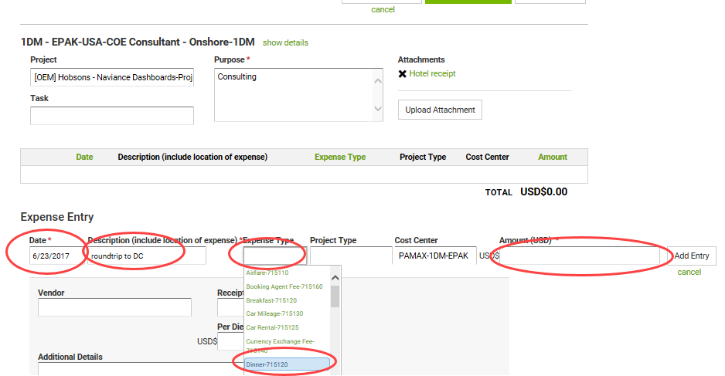
Enter Time / Enter Expense – Expense Details
Arnie
“Description” = vendor + City & State/Province
Arnie’s Diner – Dallas TX

Slide 27
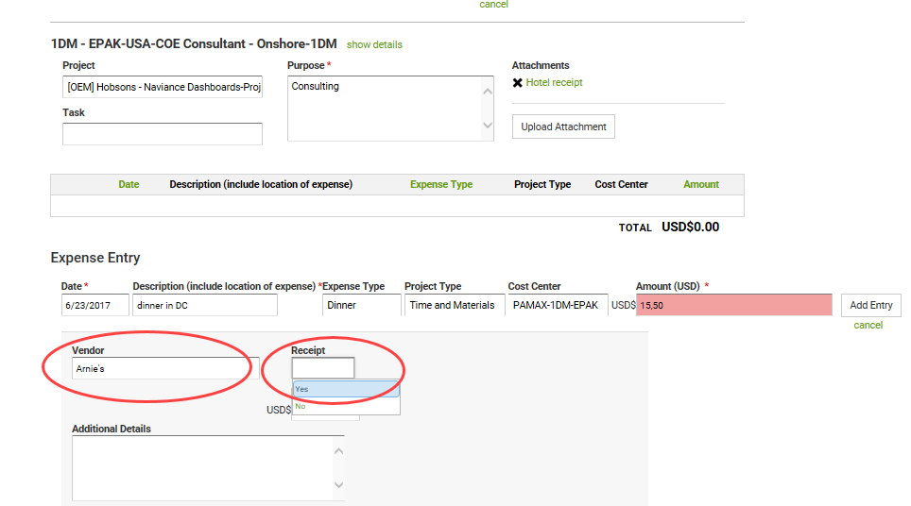
Enter Time / Enter Expense – Expense Details
Depending on the Expense Type different detail fields will appear
Always put provider name and location in ‘Description’
If “Car Mileage” type, you must include “Total Miles”
If hotel, enter room rate and room tax for one day, enter ‘1’ in ‘Nights’ field
Each night is additional entry
Arnie’s Diner – Dallas TX

Slide 28
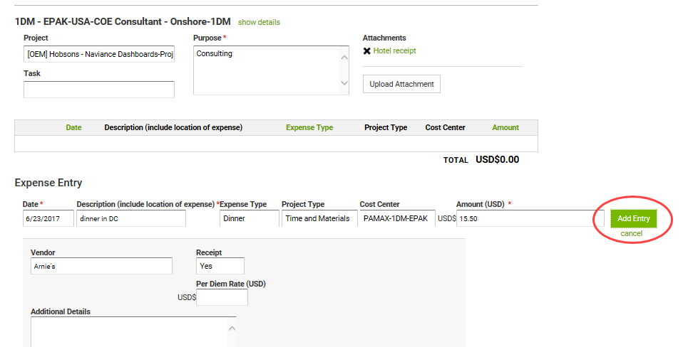
Enter Time / Enter Expense - Expenses
Arnie’s Diner – Dallas TX

Slide 29
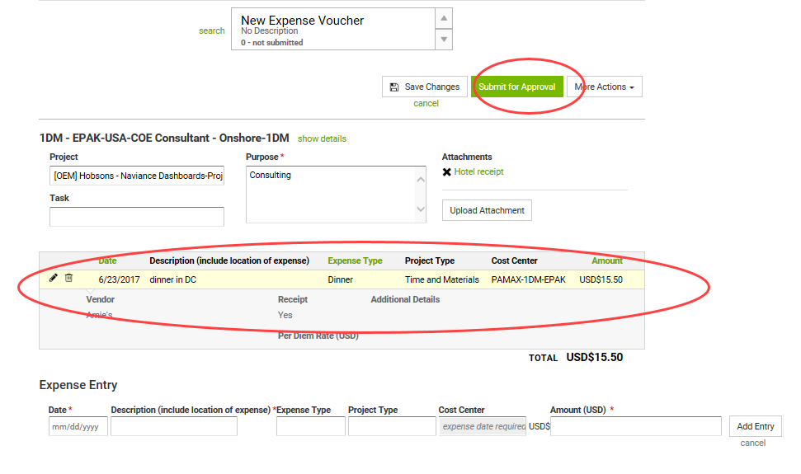
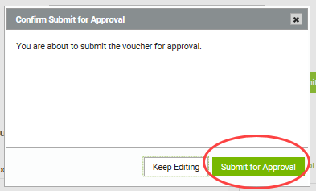
Enter Time / Enter Expense - Expenses
Arnie’s Diner – Dallas TX

Slide 30
Dale Menefee – Sr. Delivery Partner Manager
Dale.Menefee@Infor.com 440-724-4780
Notes:
Dale is first contact for Suppliers

