Slide 1
Infor Vendor Management System (VMS) Supplier Training Update: Subcontract Rate Negotiation
Dale Menefee
Sr. Delivery Partner Manager
3rd Party Management Office
Notes:
This training session updates & adds to the base Supplier training presented the week of October 23
This is additional information & does not replace anything in the Base Supplier training – augments

Slide 2
Purpose of this Supplier VMS update
To demonstrate additional, focused functionality in VMS around subcontractor rate negotiations, beyond what is provided in base Supplier training
How to counter rates included in initial Request, with specific rates when proposing Candidate
Base Supplier training demonstrates counterproposal at time of Offer Accept/ Reject
Saves cycles; if candidate is selected, Offer can come with your proposed rate incorporated in first pass
Notes:
Rate counterproposal can be done two places
When proposing a Candidate in response to a Request - Supplier is able to update the Request with desired rates
After an Offer is made – must reject Offer & use Comments field

Slide 3
Managing Requests – Propose Resources / Submit Candidates,
including New Rate Proposal

Slide 4
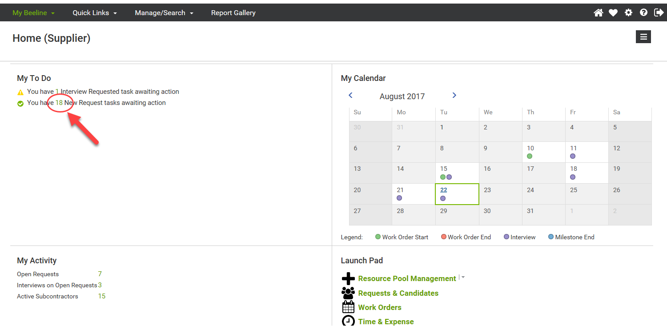
Propose Resources / Submit Candidates
Notes:
The first several slides are duplicated from the Base Supplier Training deck, to set the stage for the new information

Slide 5
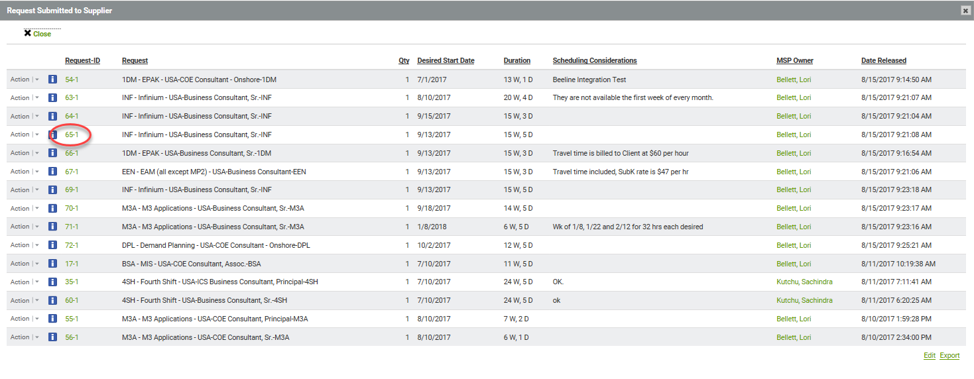
Propose Resources / Submit Candidates
** this slide copied from Base Supplier Training deck, slide #36**

Slide 6
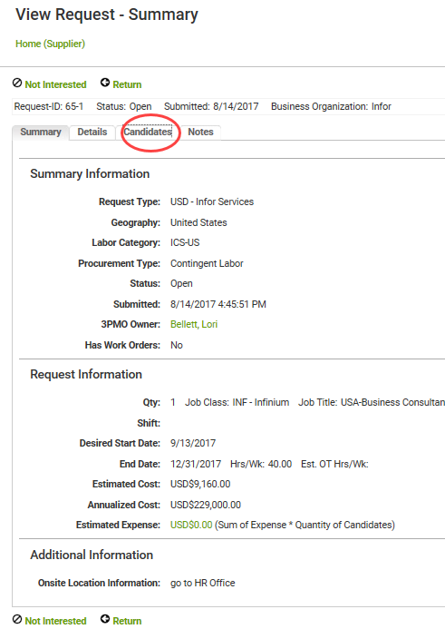
Propose Resources / Submit Candidates
** this slide copied from Base Supplier Training deck, slide #37 **

Slide 7
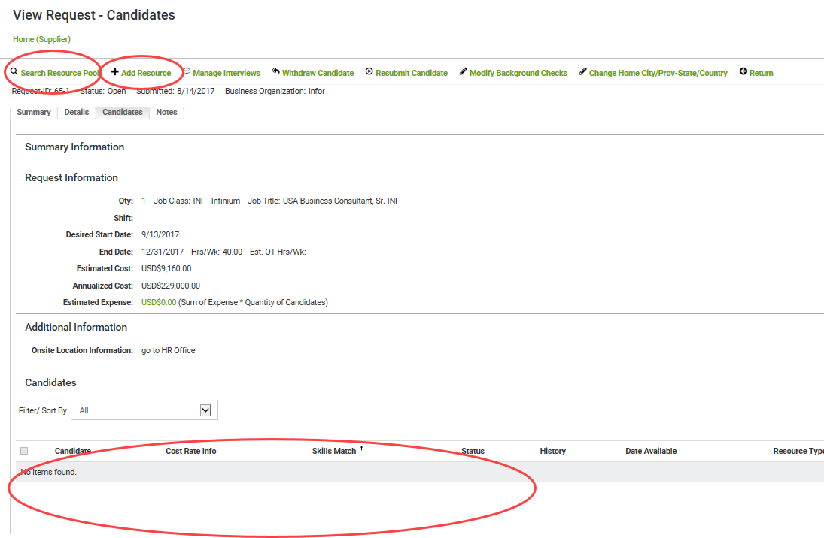
Propose Resources / Submit Candidates
** this slide copied from Base Supplier Training deck, slide #38 **
Propose resources from pool
Or
Add a new profile & propose
View of resources already proposed – currently none

Slide 8
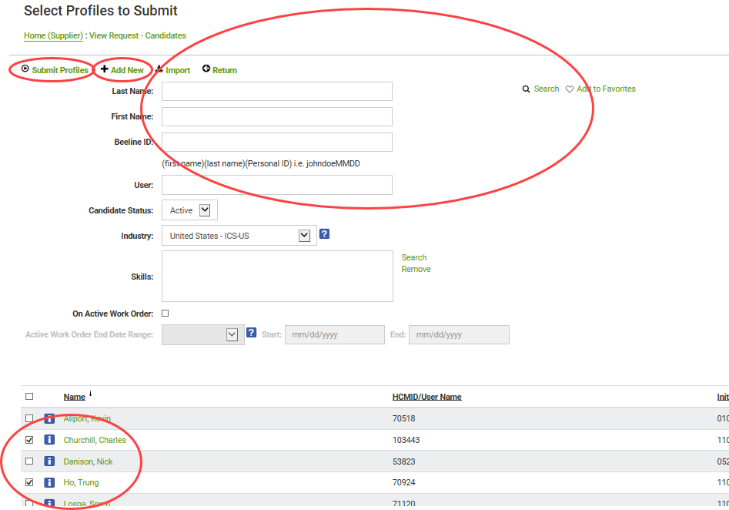
Propose Resources / Submit Candidates
** this slide copied from Base Supplier Training deck, slide #39 **
Can add new profile & submit
Can filter list below
With Search
Select profiles & click Submit

Slide 9
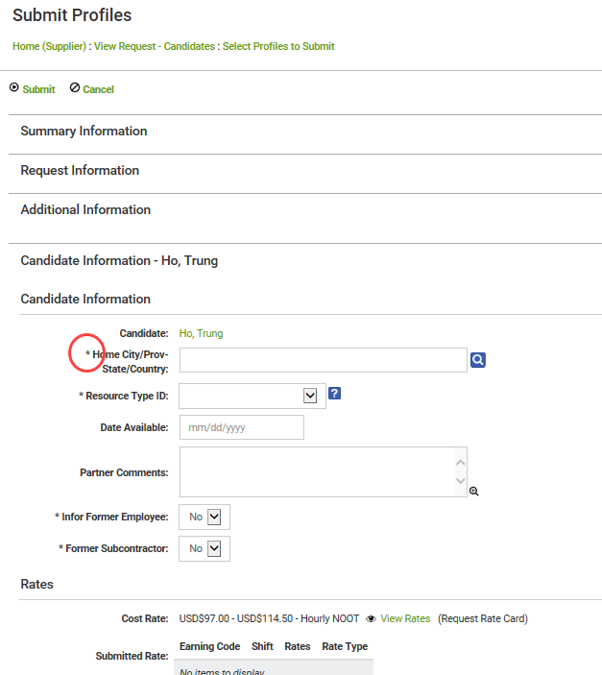
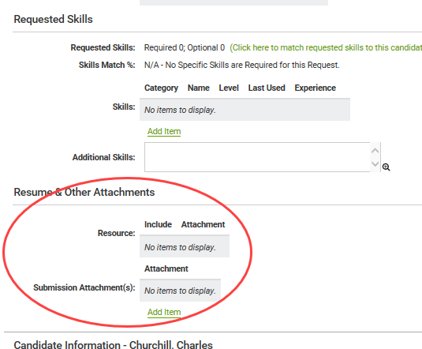
Propose Resources / Submit Candidates
** this slide copied from Base Supplier Training deck, slide #40 **
Provide any missing information, add comments, attach resumes, etc
Anything with a red asterisk is required
New Section, for counter-proposing rates

Slide 10
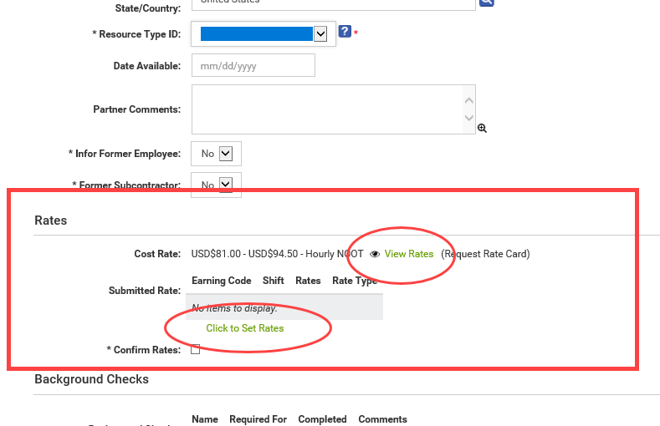
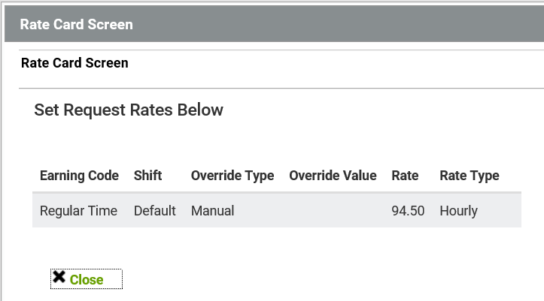
Propose Resources / Submit Candidates
View proposed rates
Counter / propose new rates

Slide 11
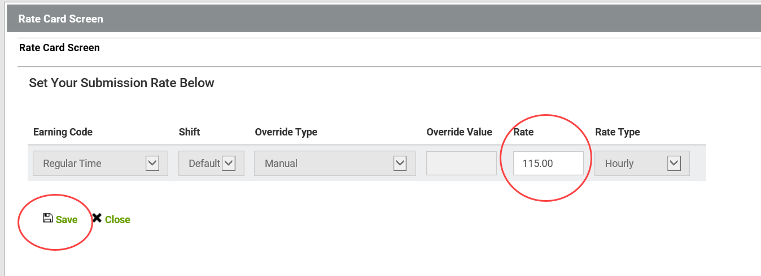
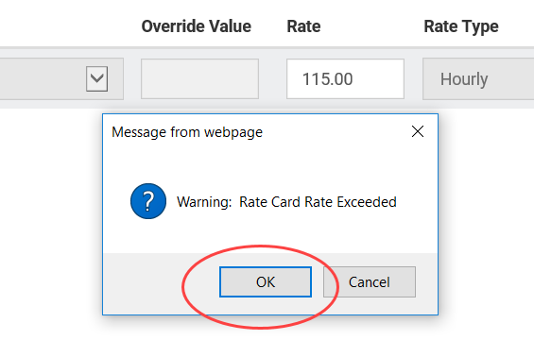
Propose Resources / Submit Candidates
Counter / propose new rates

Slide 12
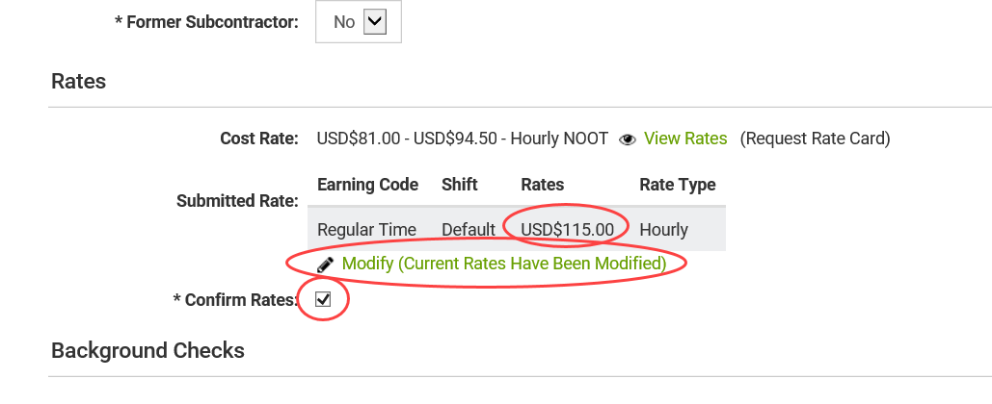
Propose Resources / Submit Candidates
Counter proposed Rate displayed
Informational message noting Rate counterproposal
Must check box to complete counterproposal

Slide 13
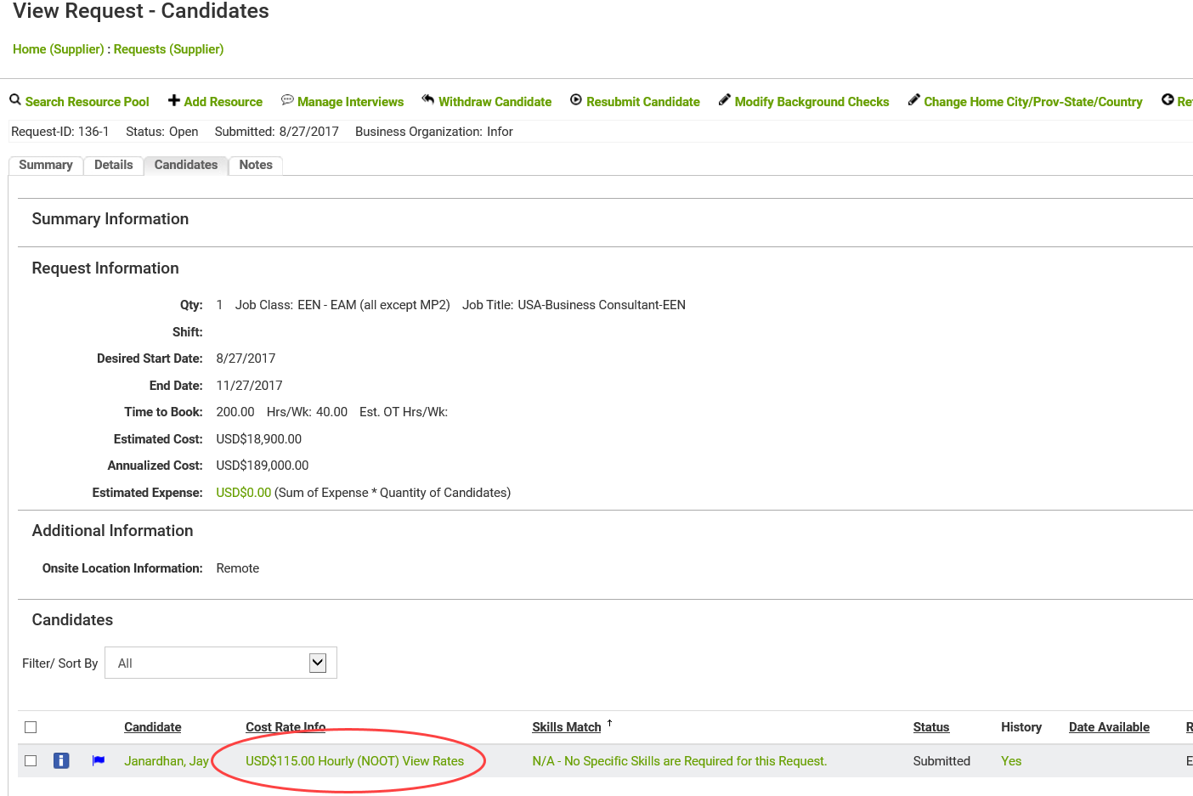
Propose Resources / Submit Candidates
Proposed candidate(s) now show in list, with proposed rates

Slide 14
Managing Offers Accept or Decline/Reject Offers … Negotiate

Slide 15
Managing Offers
Different rates here indicate a counterproposal was made
Supplier proposed rate
Current offer rate

Slide 16
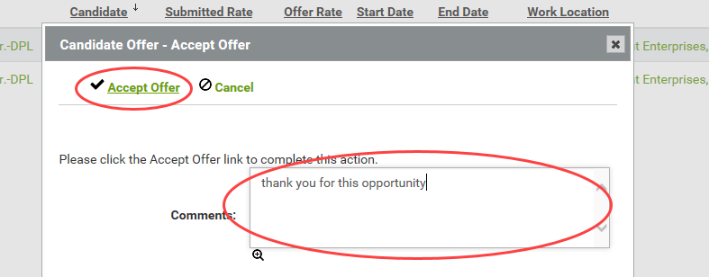
Managing Offers Accept Offer with no Rate Counterproposal

Slide 17
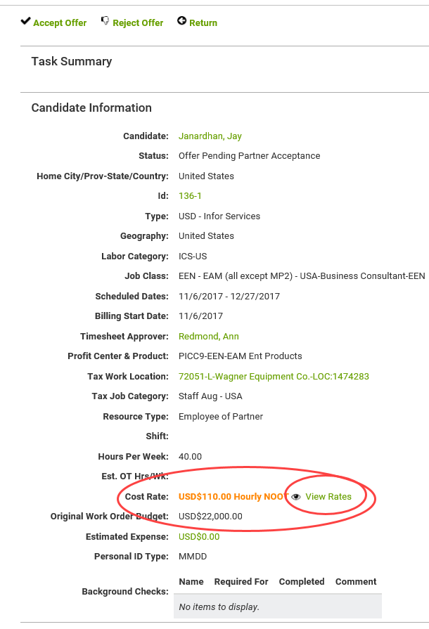
Managing Offers – Negotiate Rate

Slide 18
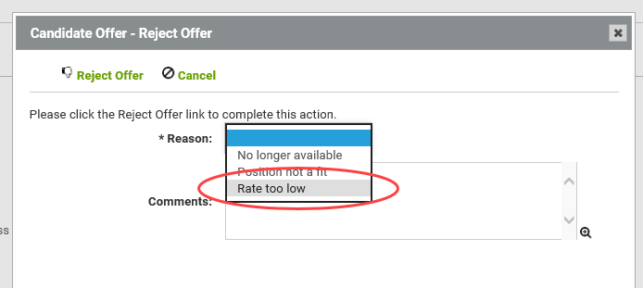
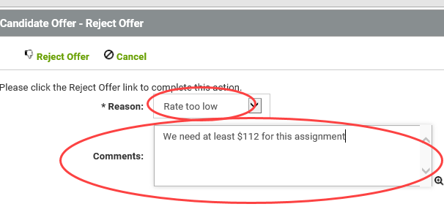
Propose Resources / Submit Candidates
Must reject Offer & propose revised rates in Comments
Sourcing Specialist will receive Rejection & can re-Offer
(rates may or may not change)

Slide 19
Dale Menefee – Sr. Delivery Partner Manager
Dale.Menefee@Infor.com 440-724-4780
Notes:
Dale is first contact for Suppliers

Slide 21
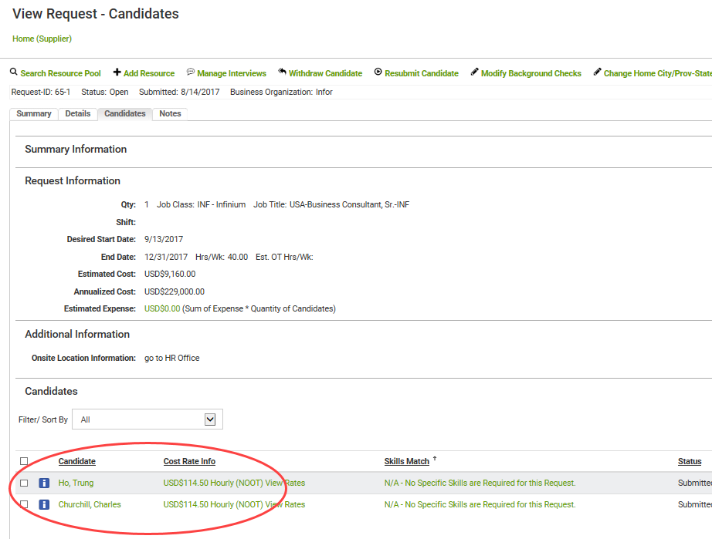
Propose Resources / Submit Candidates
** this slide copied from Base Supplier Training deck **
Proposed resources now appear in list

Slide 22
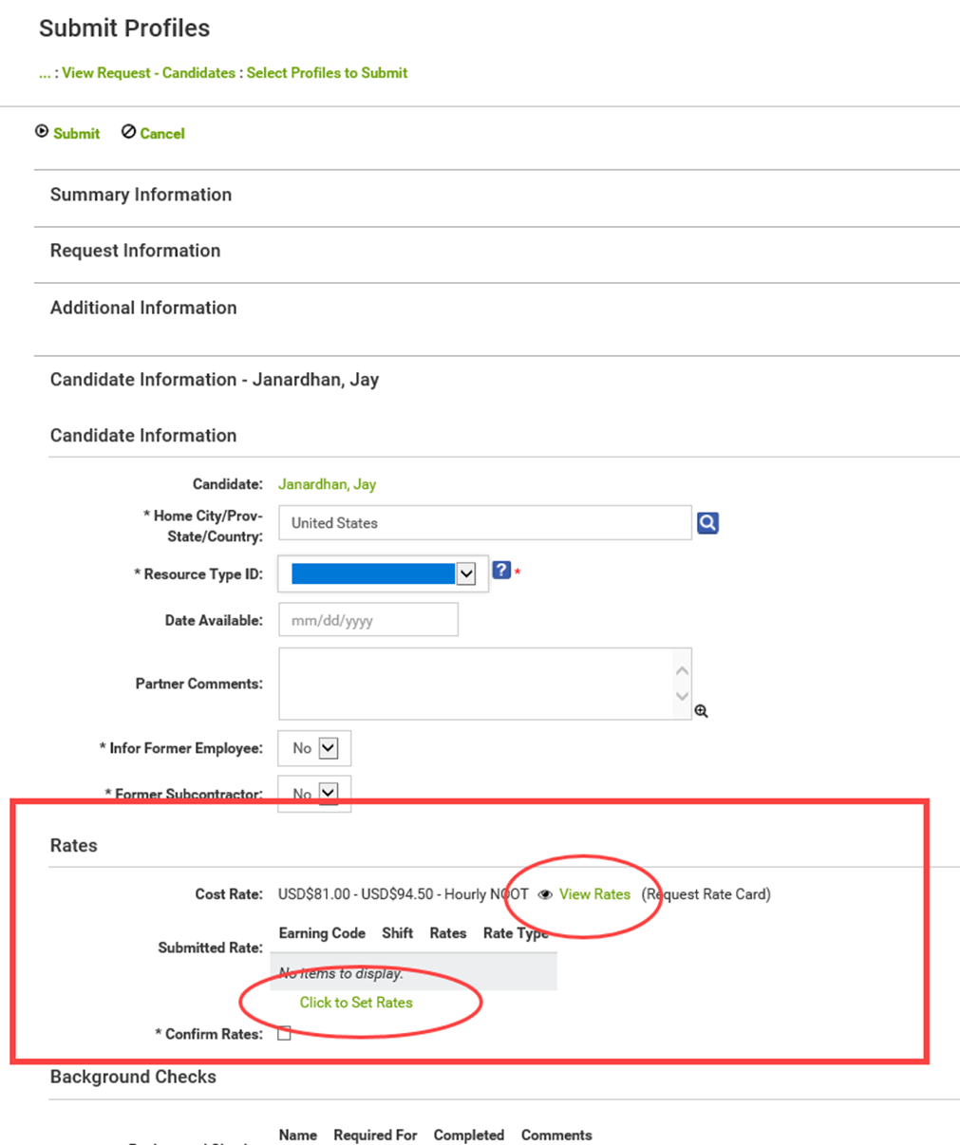
Propose Resources / Submit Candidates

