Slide 1
Infor Vendor Management System (VMS) Supplier Training
Dale Menefee
Sr. Delivery Partner Manager
3rd Party Management Office
Notes:
Welcome to the Vendor Management System Overview Training Course; commonly referred to as VMS
The goal of this module is to introduce you to the general operations and terms used in the VMS

Slide 2
Objectives
At the end of this session you will understand:
VMS Features and Functions
VMS Roles and Responsibilities
VMS Supplier Workflow
How to process Supplier and Worker transactions and use Reports in VMS
Notes:
At the end of the module you will be able to:
Identify the relationship between Beeline, Infor, Suppliers, and Subcontractors
Understand Infor’s Vendor Management System also know as VMS
Understand the various VMS Roles and Responsibilities, and
Understand the basic VMS Workflow

Slide 3
Understanding the Vendor Management System

Slide 4
Understanding the Vendor Management System
Vendor Management System – commonly referred to as a VMS
It is a system designed for the procurement and management of subcontractors
Beeline is the VMS that Infor Services has implemented
Beeline and Infor have configured the VMS according to Infor’s business needs
The VMS will be used by all subcontract labor Suppliers, their Workers, and Infor
The VMS will be the only means to procure and pay for a subcontractor
Notes:
Infor’s Vendor Management System or VMS is Beeline’s product that was created to streamline the process of hiring temporary workers.
It automates the process of procuring, managing and analyzing contingent and project based labor
The VMS is a cloud based system that is offered as a service from Beeline.
Beeline has worked with Infor to configure the VMS in a manner that best suits our business needs.
Infor, our Partners and Sub-Contracts will all be users of the system
This system will be the sole mechanism to procure and pay 3rd Party Resources utilized by Infor Services.

Slide 5
INFOR Vendor Management System
INFOR Services has selected Beeline to be our VMS provider and to assist in our implementation
Award-winning vmS
with industry-first innovations, and industry’s only software patents
Proven Integration Experience flexible configuration across multiple client platforms
16 YEARS OF SAAS LEADERSHIP
Global Presence
135 countries accessing system each week
OVER 5.2 MILLION
GLOBAL USERS
MOBILE COMPUTING: IPAD, IPHONE, BLACKBERRY, ANDROID
Notes:
This slide tells you a little more about Beeline
They provide a Saas solution on a global basis for contingent labor
They are the number one independent provider of VMS service globally

Slide 6
Vendor Management System Overview
Requisition creation & distribution to suppliers
Real time reporting and analytics
Resource profile
Interview, Acceptance
Invoicing
On/Off Boarding
Performance Metrics
Time and expenses
Notes:
For a high level overview of the VMS system: Starting at the top of the diagram:
Role requests, whether being passed from Polaris or being entered directly into Beeline for those areas not supported by Resource Management, begin the process
A request is then sent to the Suppliers, who will then submit candidates to begin the process of reviewing profiles, interviewing and candidate selection
Once a Candidate is selected, they will be on-boarded and the Request becomes an Assignment
The Candidate will enter their Time and Expenses into the VMS, and this is also where the PM will approve or reject the Time and Expenses.
The VMS will provide various Performance Metrics necessary to run our business
Supplier Invoicing will be done based on approved time and expense within the VMS
The VMS will provide Real Time Reporting and Analytics
I am now going to show you two sample screens from Beeline

Slide 7
Transition from Current State to Future State with VMS
Clarity
(Projects)
Softrax
(Billing)
Customer ID & Address data
Employee & SubContr.
Time & Expense data
Billing data to GL
Smart-stream
(AP / GL)
Resource data
SubK T/E
HCM.11
(HR)
Project/ Task data
VMS
Manual entry of T/E into Clarity
Invoice from Beeline
HCMID
Manual
matching of Invoice to PO
Email
Supplier Invoicing & T/E
Create Worker
Project data
Employee & SubContractor
Polaris
(Internal Resource
Mgmt)
Role data
Booking data
3P Status
Sharepoint
3P Sourcing
eFlow approval
Initiate PO
Excel macro to load role data
Manual Data entry in SharePoint & eFLOW
Notes:
This slide shows the Transition from Infor’s Current State to the Future State with the VMS. The boxes in gray are the current manual activities that will be automated by the implementation of the VMS tool.

Slide 8
VMS Roles - Supplier
Supplier (Manager) – Supplier is the term for a subcontract labor provider. Also referred to as vendor or partner. Some of the functions of the Supplier Manager in VMS include:
Adding Resource Profiles
Submitting Resource Profiles to requests
Accept/Reject Offers
Approve/Reject Amendments/Extensions
Supplier (Admin) – All the same functions as Supplier (Manager) with the addition of User Administration
Worker also referred to as Resource – this is a billing consultant. A Worker has access to only one area in Infor VMS: Time and Expense entry
Notes:
The Supplier is an organization that provides Sub-Contractors to Infor. A Supplier can be a Partner, Consulting or Staffing Company that has been provided access to the VMS by Infor and has an established sub-contracting agreement with Infor. Suppliers are also referred to as Vendors or Partners. The Supplier uses the VMS to Add Resource Profiles, Submit Candidates to Requests, accept or reject offers by Infor to engage a Candidate and approve or reject amendments or extensions.
Subcontractors are individuals who accept assignments on a contingent or contractual basis. They will use VMS to enter their time and expenses against the projects and tasks that have been set up for them.

Slide 9
VMS Roles - Infor
Sourcing Specialist (SS) – Some of the functions of the SS in VMS include:
Releasing Requests
Qualifying/Disqualifying Resources
Making Offers
On-boarding/Off-boarding Resources
Assignment Maintenance
Project Manager (PM) – Some of the functions of the PM in VMS include:
Requesting an interview
Selecting/Disqualifying Sub-Contractors
On-boarding Sub-Contractors
Amending/Extending Sub-Contractor Assignments
Approval/Rejection of Time and Expenses of Sub-Contractor
Approver – Will approve or reject the Work Order once the Sub-Contractor has been chosen, or Time/Expense entry prior to invoicing
Notes:
Within the VMS there are several roles with specific responsibilities. The role responsibilities outlined here are the ones most commonly used.
The Project Manger determines Infor’s needs and uses VMS to request interviews, qualify or disqualify resources, on-boards resources, and amends or extends assignments. In addition, VMS will be used for the approval or rejection of time and expenses.
Approvers will approve or reject the work orders, which our replacing our current Purchase Orders, that are submitted once the Resource is chosen. The people that will have an Approval role in the VMS are the same people who are specified in the Infor Approval Matrix.
The Sourcing Specialist uses VMS to release role requests to our Partners in an automated, tiered fashion. The Sourcing Specialist also reviews submitted candidates and forwards qualified candidates to the Project Managers. Within the Sourcing Specialist role, the VMS also offers an automated means to request interviews, make offers, on-boards and off-board resources, and assignment maintenance.

Slide 10
Additional VMS Terms
Assignment: A Request becomes an Assignment once a Resource has been On-Boarded.
Work Order: Record in VMS of accepted, committed subcontract work with start/end dates, pay rate, project details, named Supplier and Worker, etc. Time and Expenses are reported against the Work Order in VMS.
Extension: Modification to a Work Order that changes the start or end dates without changing the budget
Amendment: Modification to a Work Order that changes the budget, e.g. adding hours

Slide 11
INFOR Vendor Management System North America Launch Timetable
Task | Deadline
System QA & User Acceptance Testing | Current through early October
Weekly Supplier touchbase calls | Through go-live
Collection of contract Addendums and initial profile PROD upload data | Through October
“Blackout” period | Mon Oct 23 – Fri Nov 03
Supplier and Worker Training | Mon Oct 23 – Fri Oct 27
Go-Live: System opened to user access | Mon Nov 06
T&E entry: For Nov 01-Nov 03 For week of Nov 04 – Nov 10 | ASAP beginning Monday Nov 06 By Saturday Nov 11, this begins the regular weekly cycle
UPDATED
NEW GO-LIVE DATE DECEMBER 4, 2017

Slide 12
Infor VMS Supplier / Worker Training

Slide 13
INFOR Vendor Management System Supplier and Worker Training
Supplier Training | Worker Training
Monday Oct 23, 2:00 PM
 | Tuesday Oct 24, 10:00 AM
Wednesday Oct 25, 10:00 AM
Wednesday Oct 25, 6:00 PM
 | Thursday Oct 26, 7:00 AM
Friday Oct 27 7:00 AM | Friday Oct 27, 3:00 PM
‘Supplier’ training is full Supplier IVMS functionality, and includes Time & Expense entry
‘Worker’ training is for billing consultants; resources whose only interaction with IVMS will be to enter T&E
If a person attends Supplier training they will not need to also attend Worker training

Slide 14
Table of Contents
Workflow Overview
Managing Requests
Manage Resource Pool
Review Requests
Propose Resources / Submit Candidates
Manage Interviews
Managing Offers
Decline/Reject … Negotiate
Accept
Managing Work Orders
View
Extensions / Amendments
Time and Expenses
T&E Entry
T&E Admin
Reports
Administrative
User Maintenance

Slide 15
VMS Workflow

Slide 16
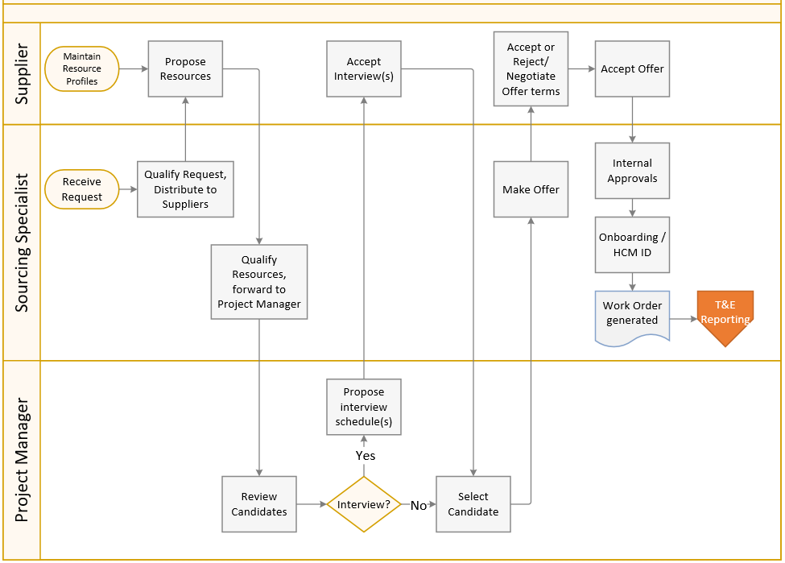
VMS Workflow – Request through WO generation

Slide 17
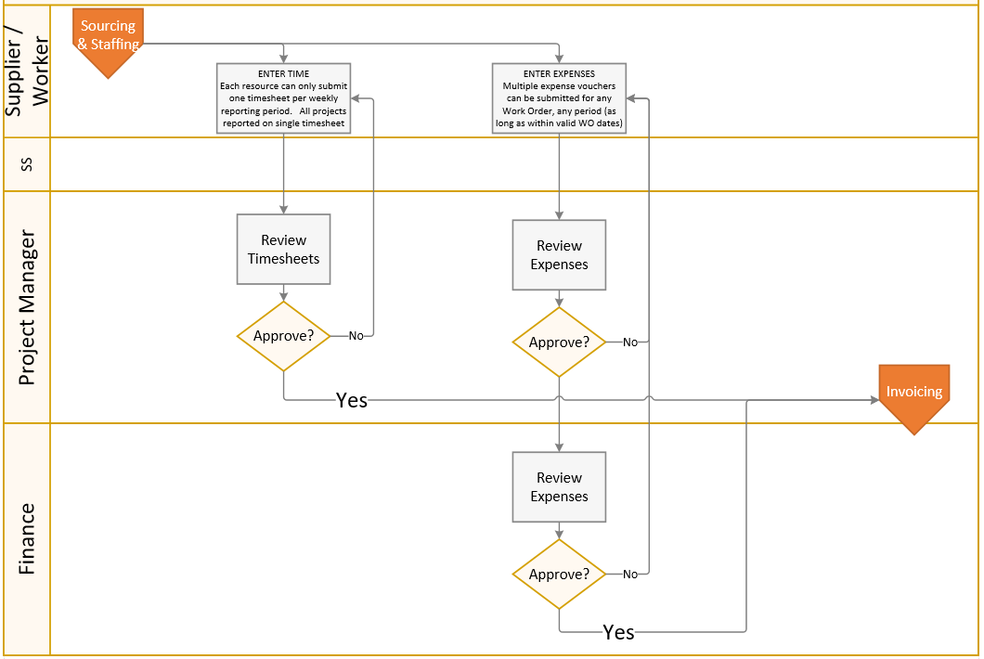
VMS Workflow – Time & Expense Reporting

Slide 18
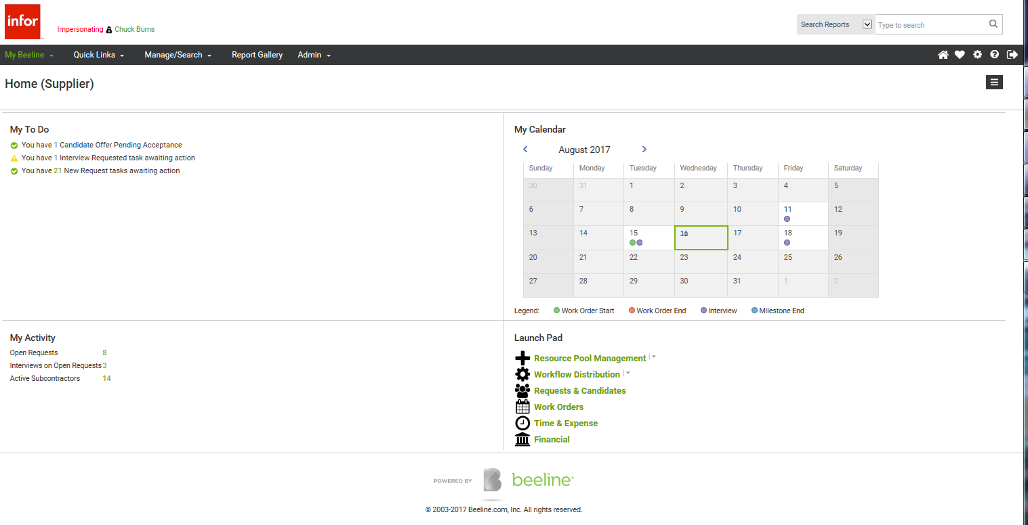
The Supplier Dashboard
Alerts
Event Calendar
Statuses
Useful links

Slide 19
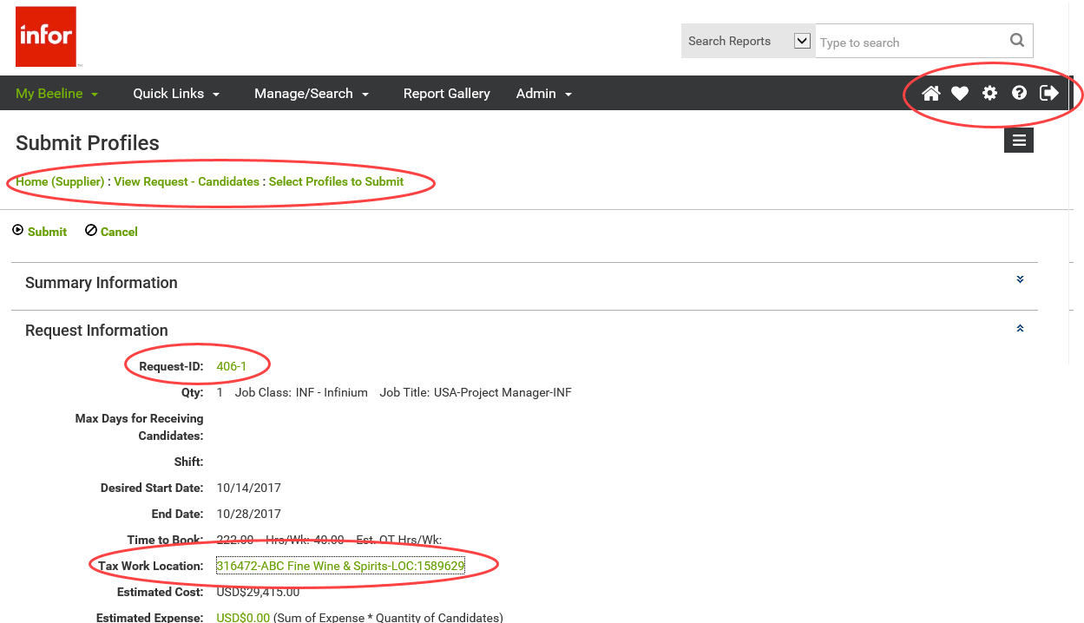
Infor Vendor Management System - Screen Navigation
“Bread crumbs”
Home
Favorites
Settings
Help
Logout
Green text = hyperlinks
Section expand/
minimize

Slide 20
Managing Requests

Slide 21
Managing Requests – Manage Resource Pool

Slide 22
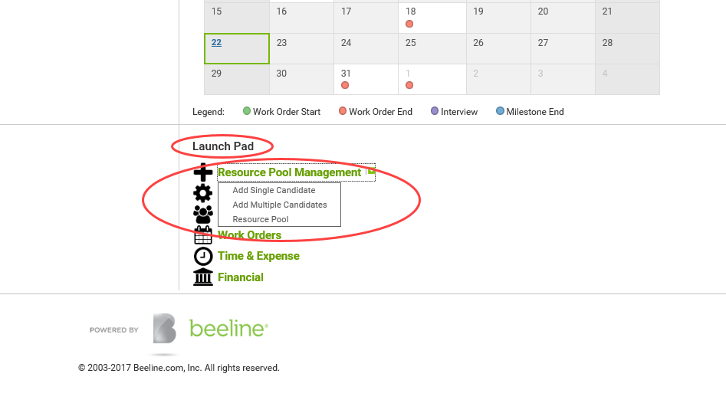
Manage Resource Pool

Slide 23
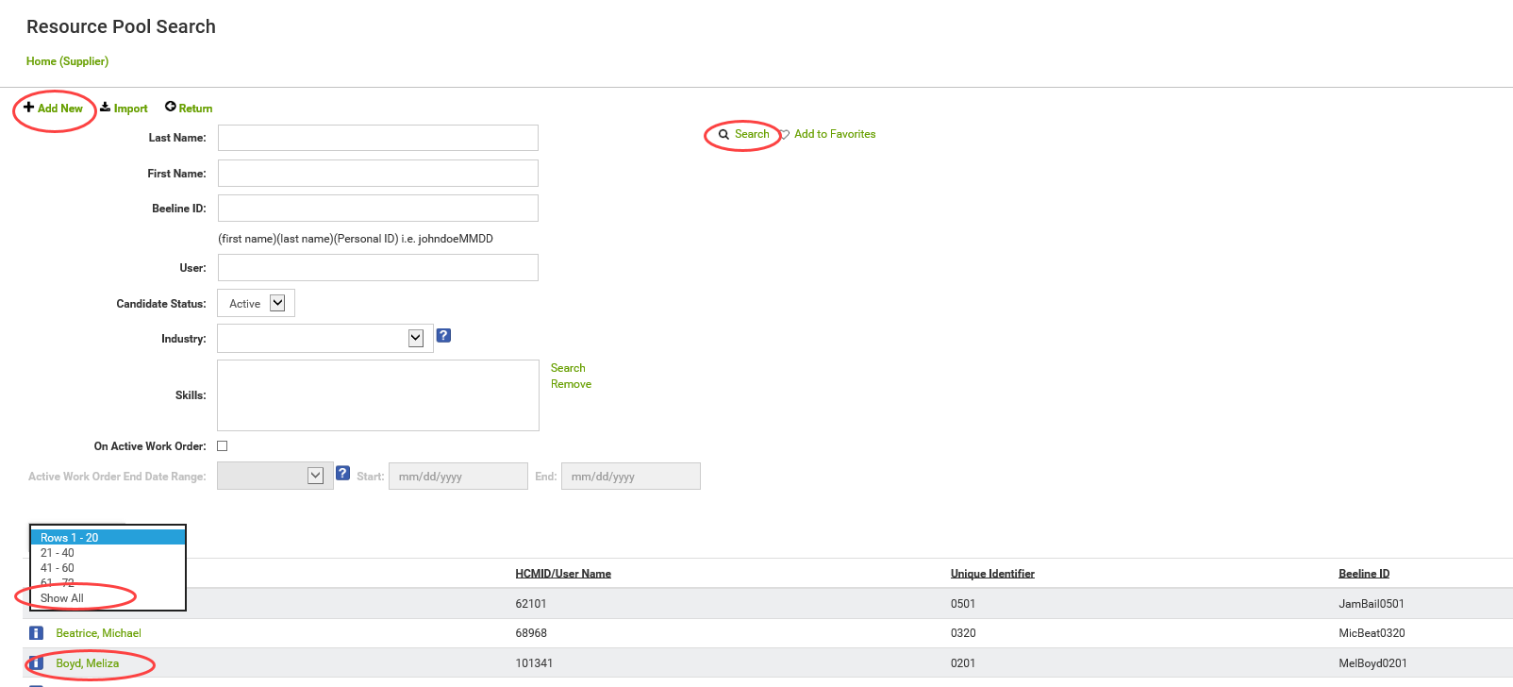
Manage Resource Pool – Resource Pool Search
Can Search
Or
View All / Edit

Slide 24
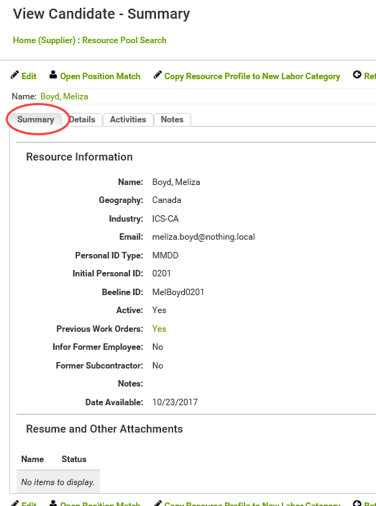
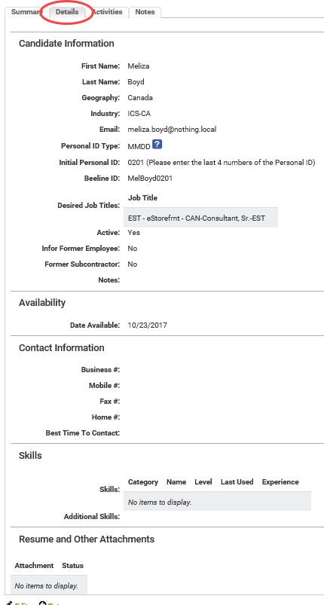
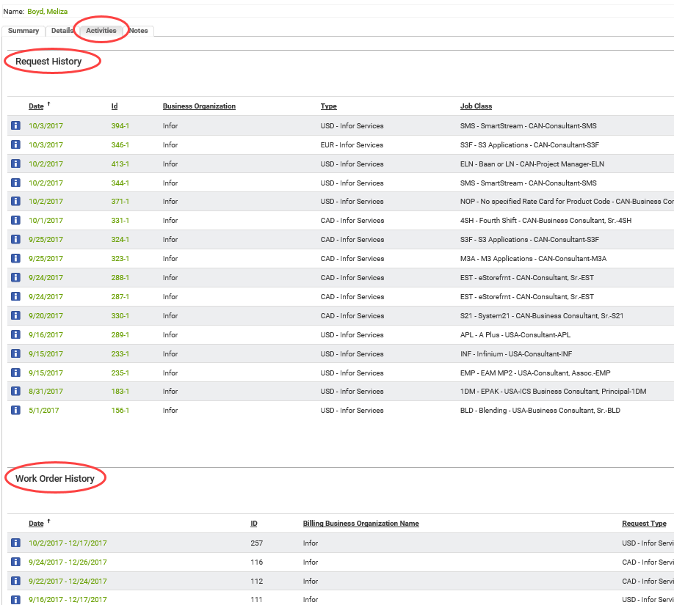
Manage Resource Pool – View / Edit Existing Resource

Slide 25
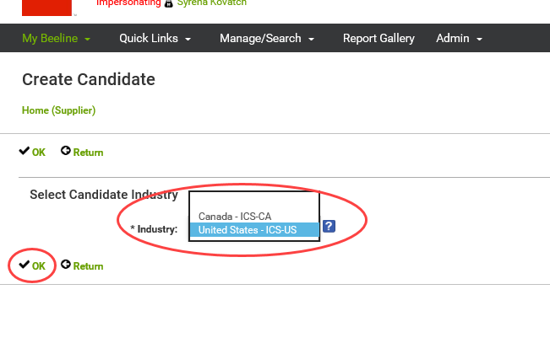
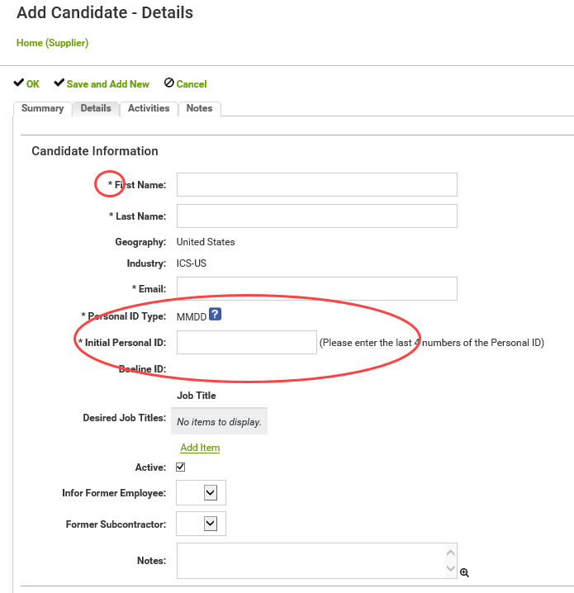
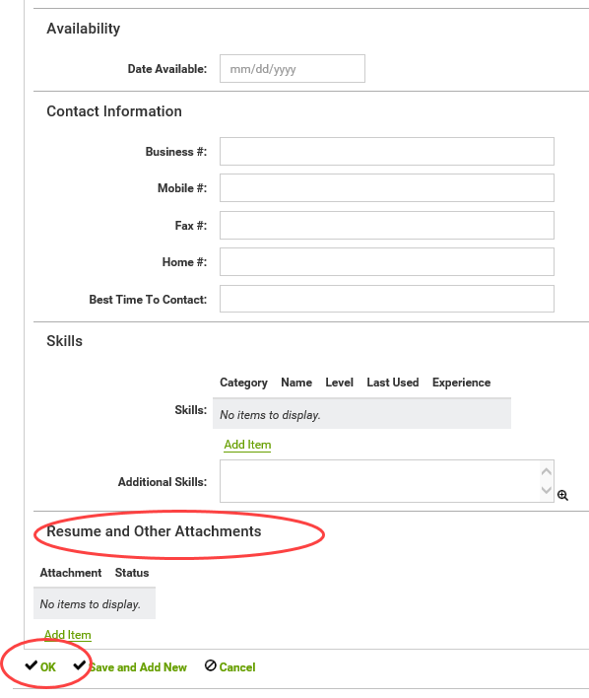
Manage Resource Pool – Add New Resource
Asterisk = Required
Month/day unique identifier

Slide 26
Managing Requests – Review Requests

Slide 27
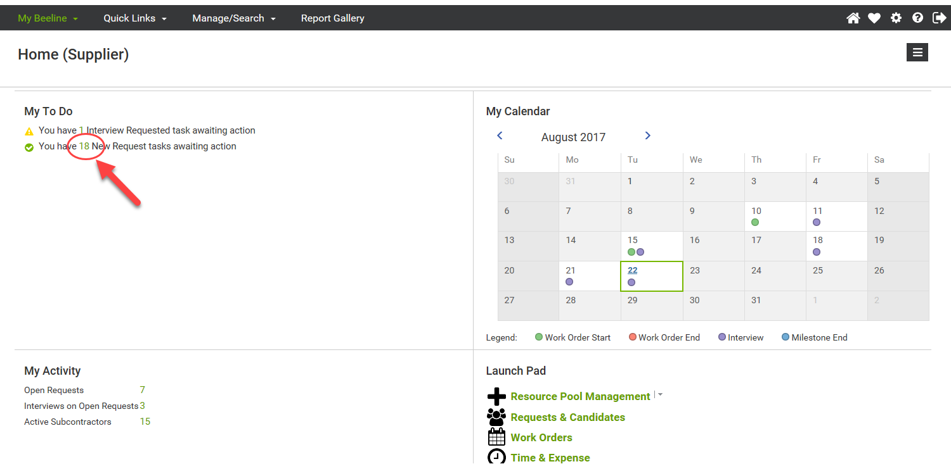
Review Request – New Request

Slide 28
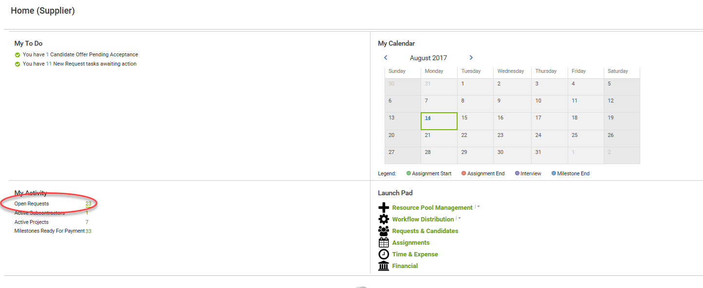
Review Request – In-Process Request

Slide 29
Review Request – In-Process Request
View open Requests & select one

Slide 30
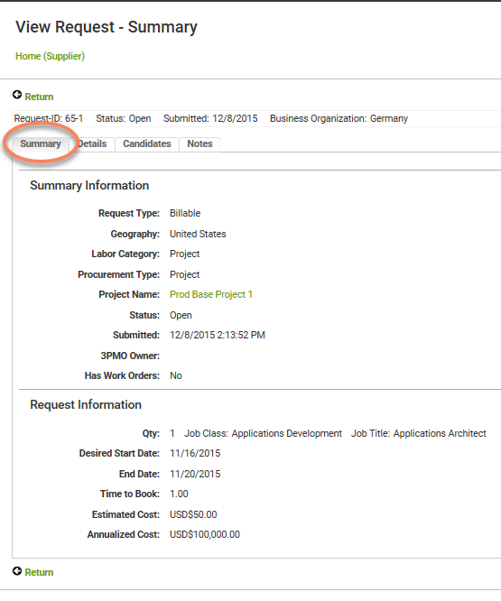
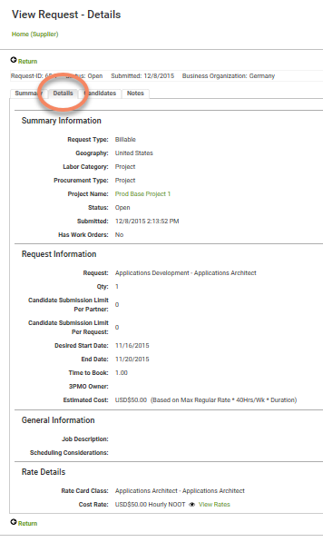
Review Request

Slide 31
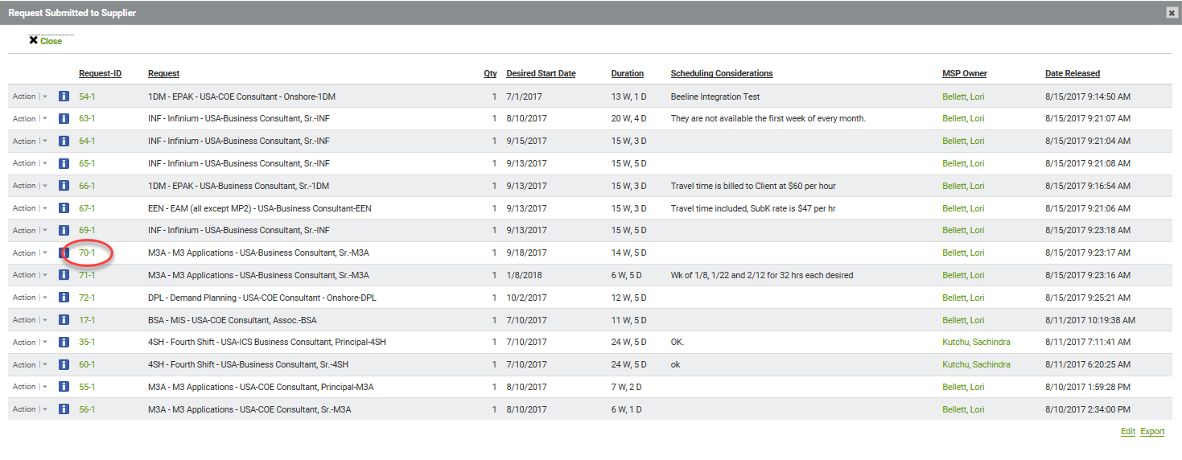
Reject Request / Decline Submission

Slide 32
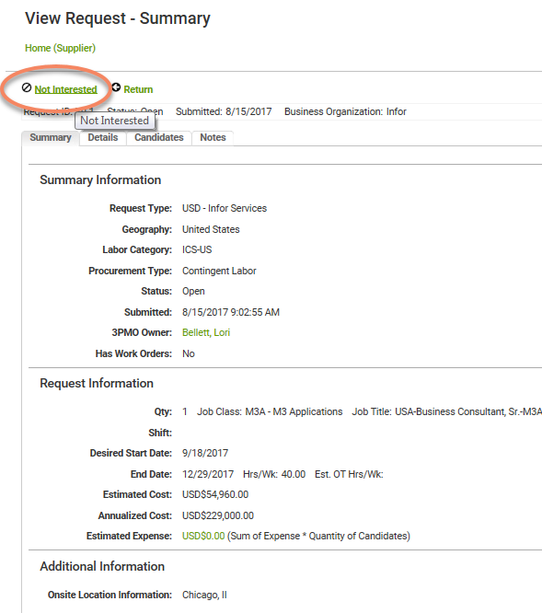
Reject Request / Decline Submission

Slide 33
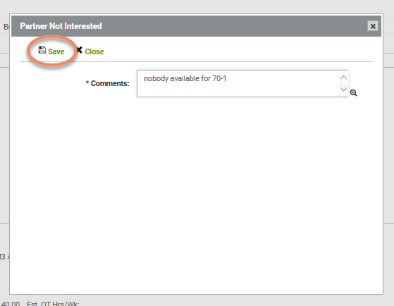
Reject Request / Decline Submission

Slide 34
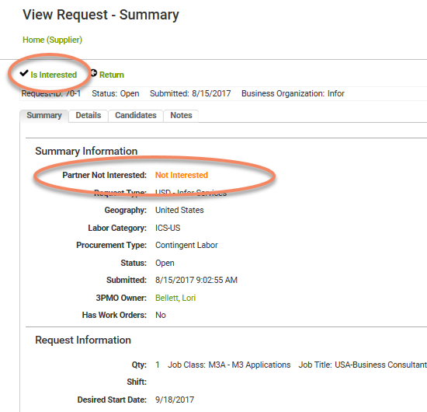
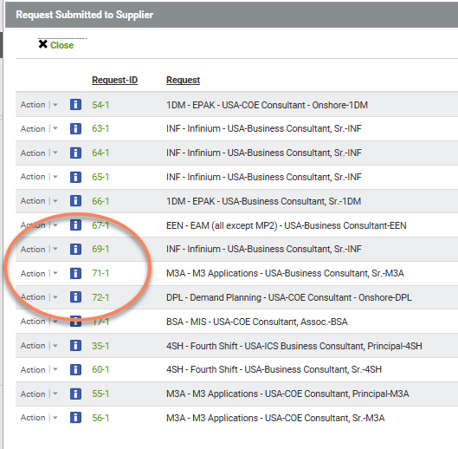
Reject Request / Decline Submission
70-1 no longer in the list

Slide 35
Managing Requests – Propose Resources / Submit Candidates

Slide 36
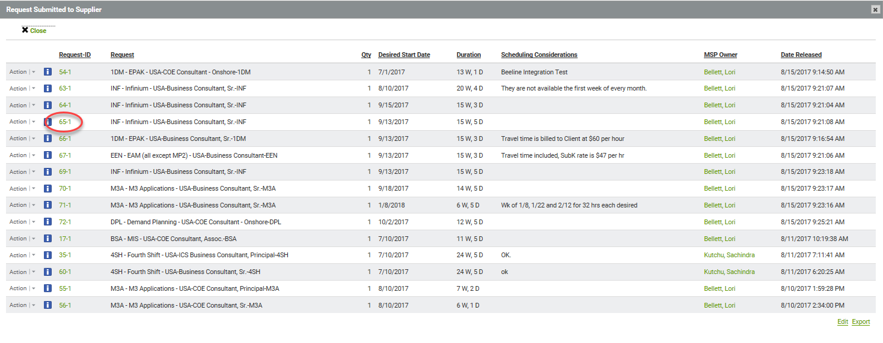
Propose Resources / Submit Candidates

Slide 37
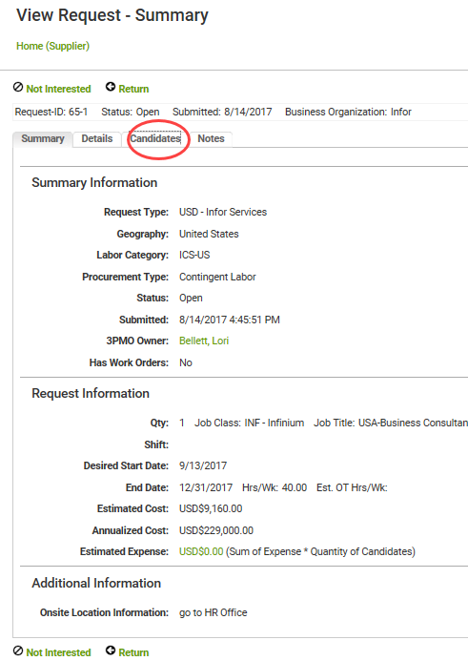
Propose Resources / Submit Candidates

Slide 38
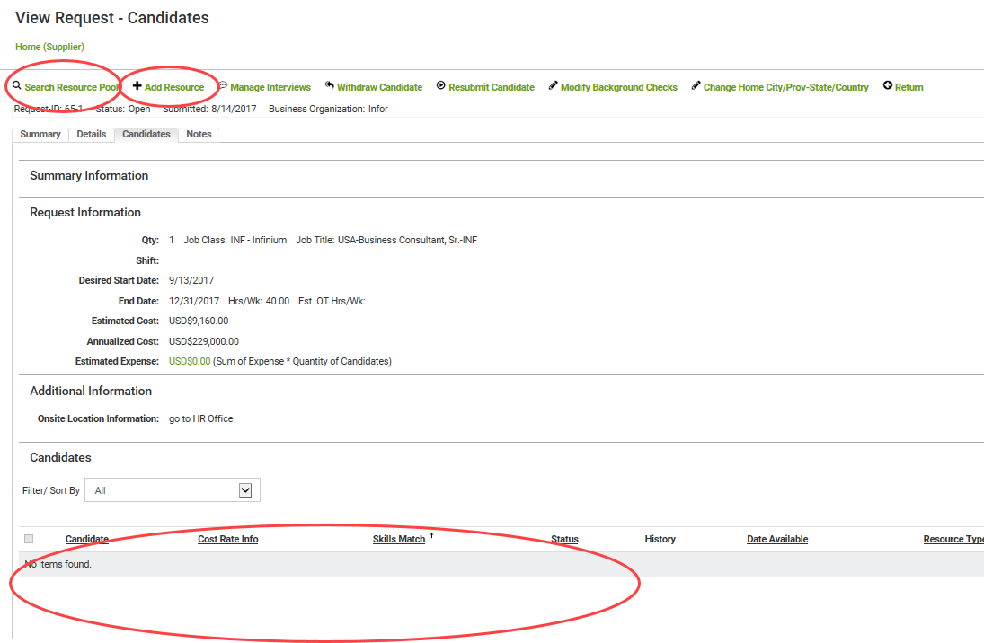
Propose Resources / Submit Candidates
Propose resources from pool
Or
Add a new profile & propose
View of resources already proposed – currently none

Slide 39
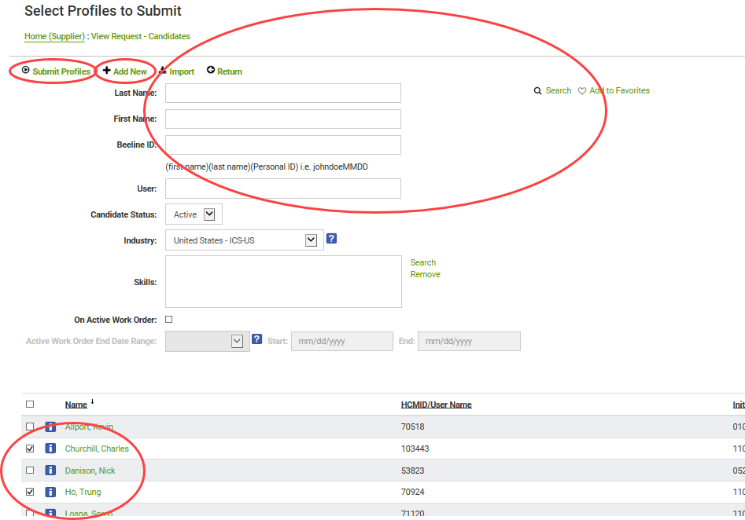
Propose Resources / Submit Candidates
Can add new profile & submit
Can filter list below
With Search
Select profiles & click Submit

Slide 40
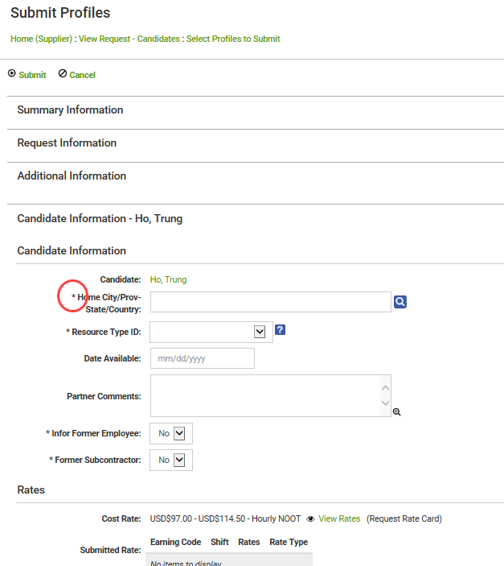
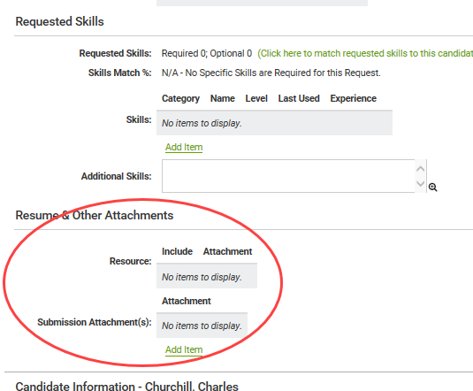
Propose Resources / Submit Candidates
Provide any missing information, add comments, attach resumes, etc
Anything with a red asterisk is required

Slide 41
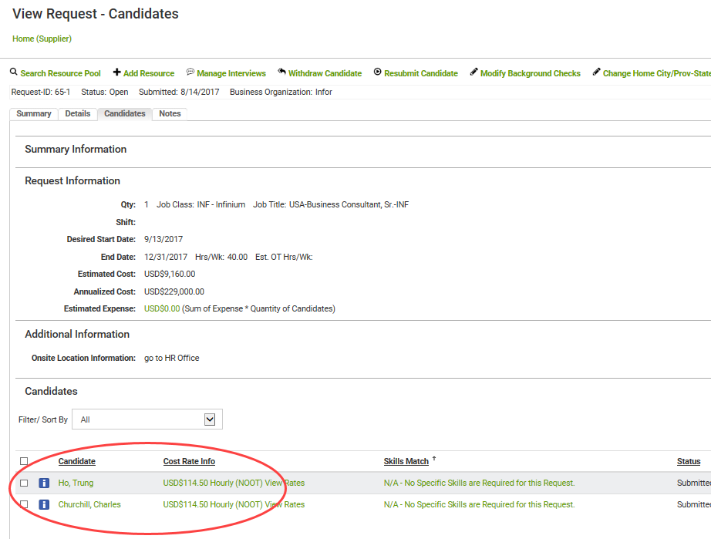
Propose Resources / Submit Candidates
Proposed resources now appear in list

Slide 42
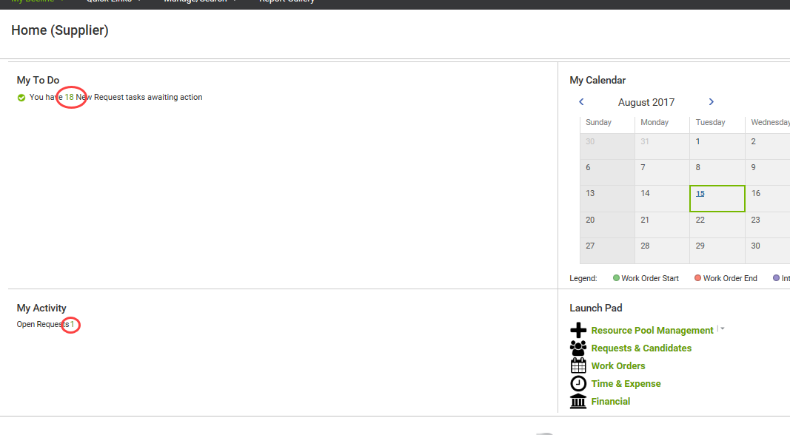
Propose Resources / Submit Candidates
Request has moved from New Requests to Open Requests

Slide 43
Managing Requests – Manage Interviews

Slide 44
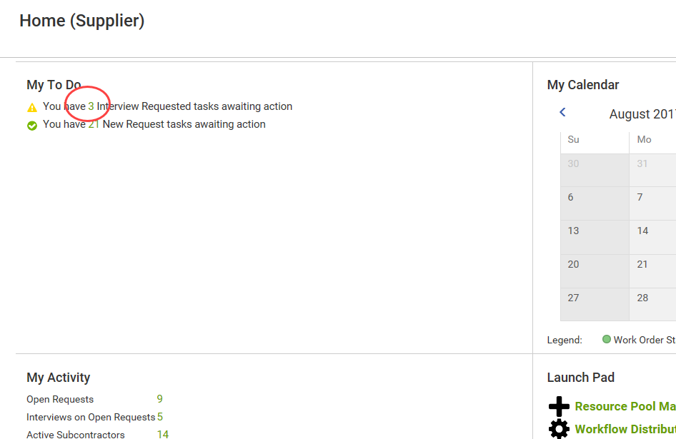
Accept Interview

Slide 45
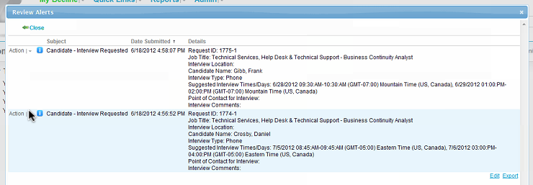
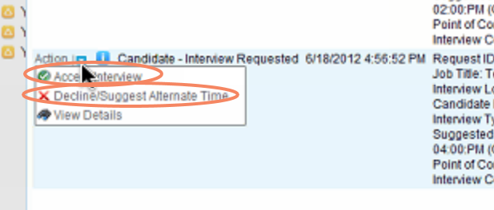
Accept Interview

Slide 46
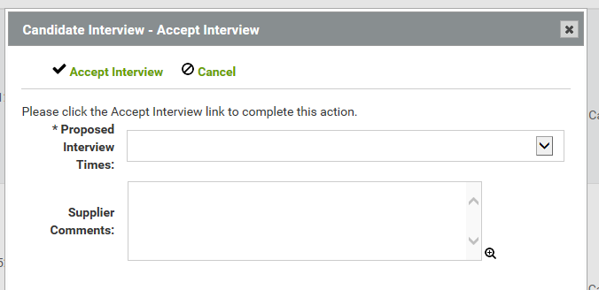
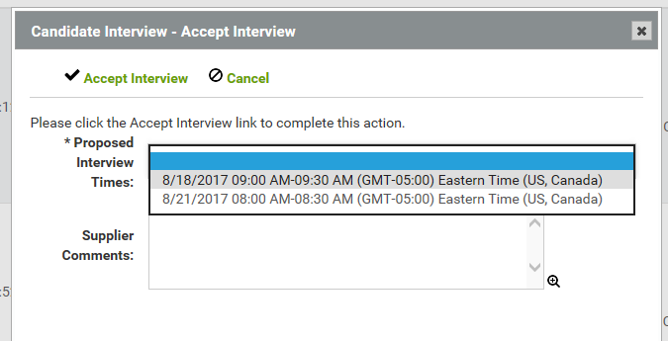
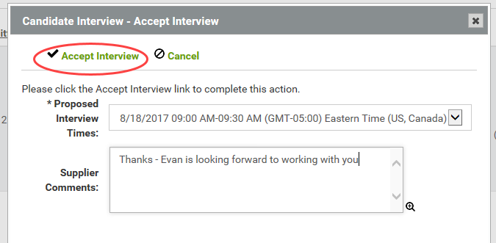
Accept Interview

Slide 47
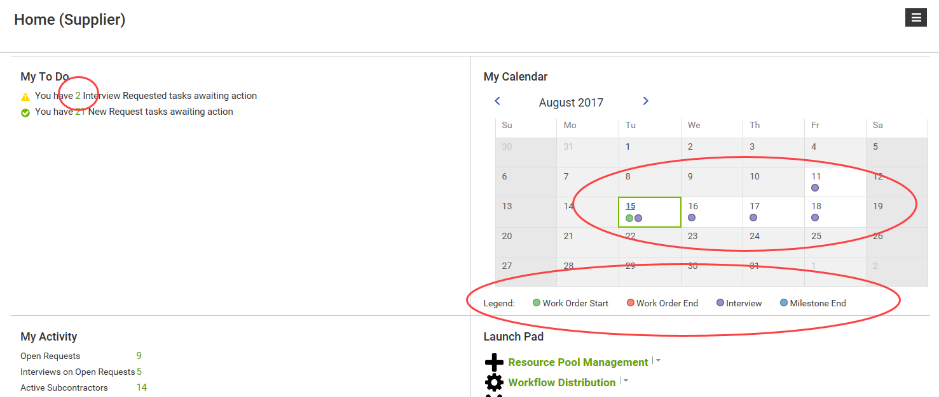
Accept Interview
My Calendar updated
Interview request counter decremented

Slide 48
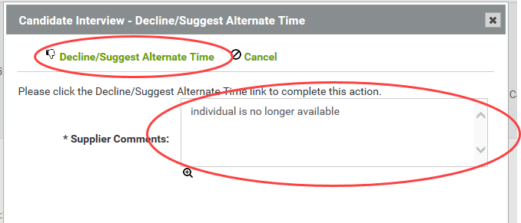
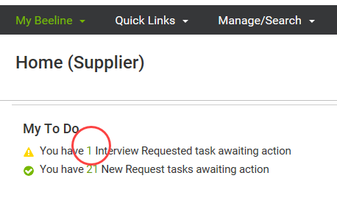
Decline / Reject Interview
Interview request counter decremented

Slide 49
Managing Requests – Offers Decline/Reject Offers … Negotiate

Slide 50
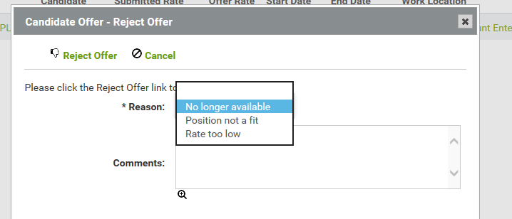
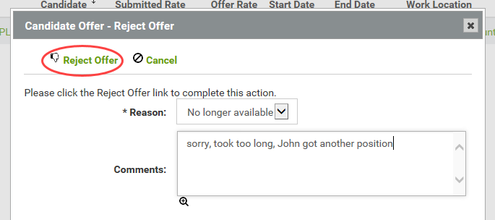
Decline / Reject Offer

Slide 51
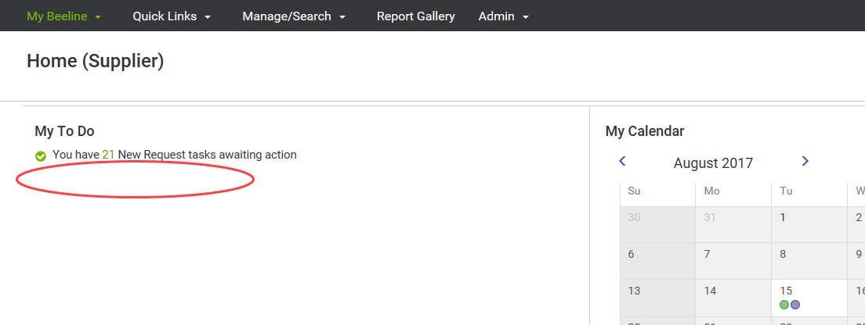
Decline / Reject Offer
Message appears briefly confirming your action, then disappears
Counter is decremented
Since that was the only one, line disappears from My To Do

Slide 52
Managing Requests – Offers Accept Offer

Slide 53
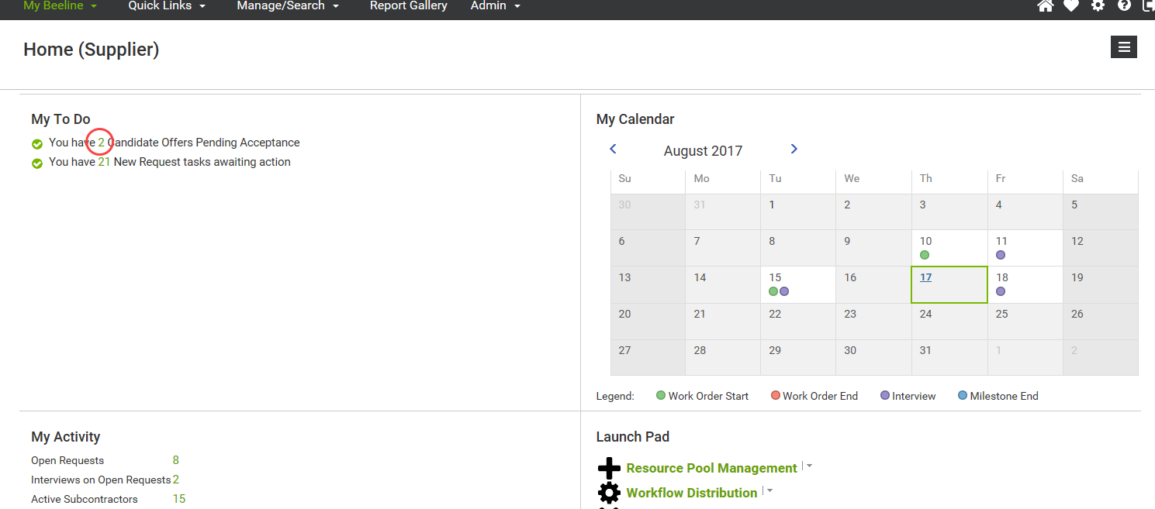
Accept Offer

Slide 54
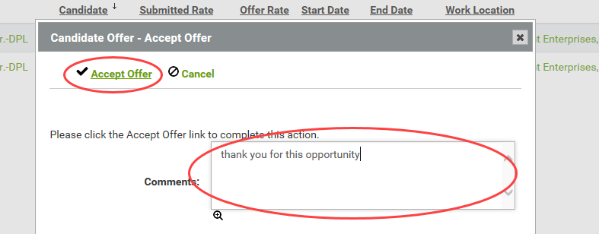
Accept Offer

Slide 55
Accept Offer
Message appears briefly confirming your action, then disappears
Accepted Assignment no longer shown on this screen

Slide 56
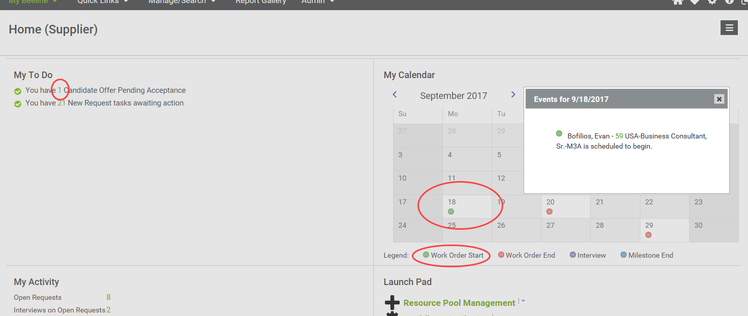
Accept Offer
Counter is decremented
Calendar is updated

Slide 57
Managing Work Orders

Slide 58
Managing Work Orders – Viewing Work Orders

Slide 59
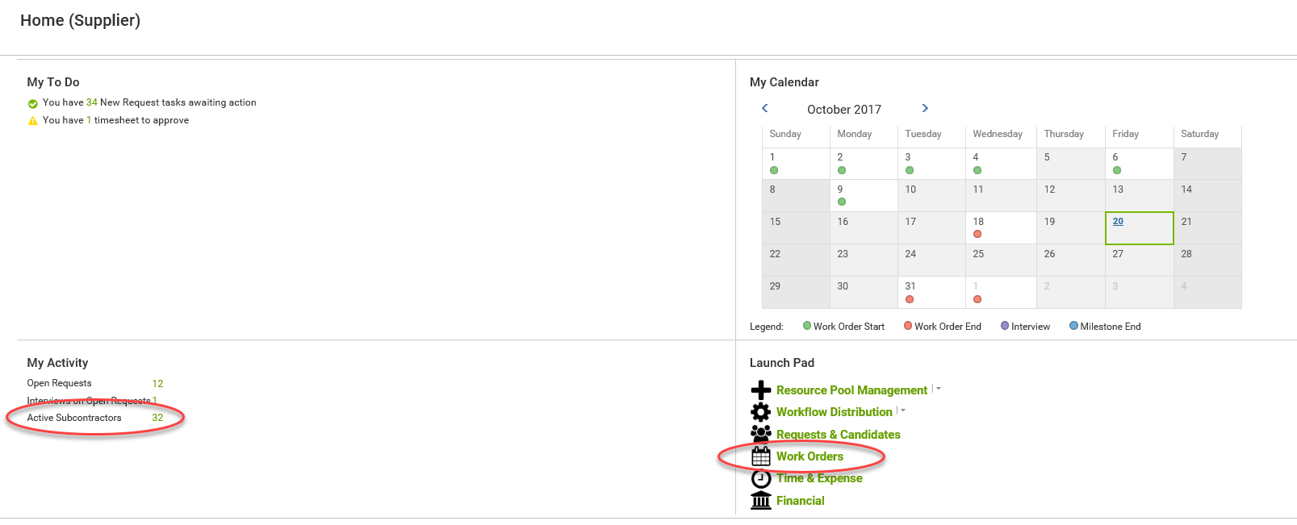
Viewing Work Orders
Lists WOs by Worker
Lists WOs
By WO #

Slide 60
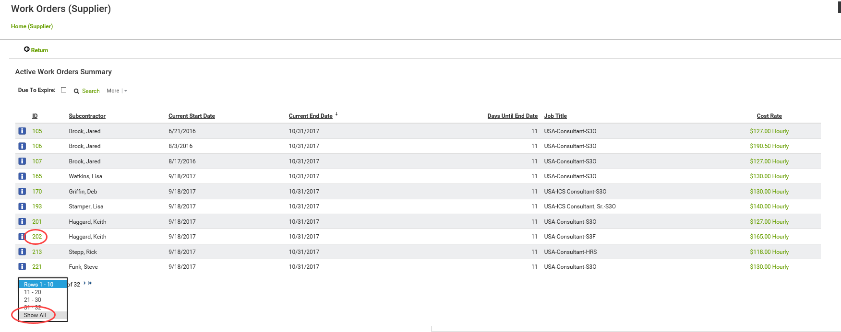
Viewing Work Orders
Can click on column heading to sort/re-sort
Select WO to View
Can page through list or Show All

Slide 61
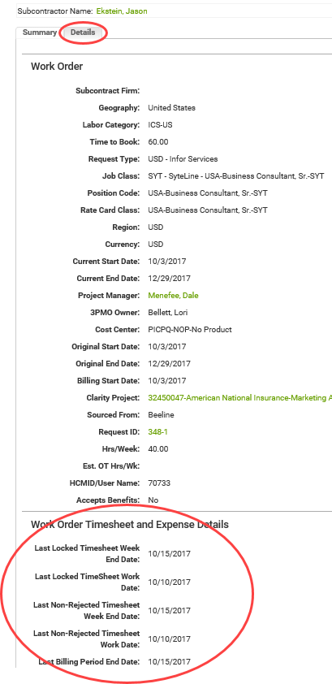
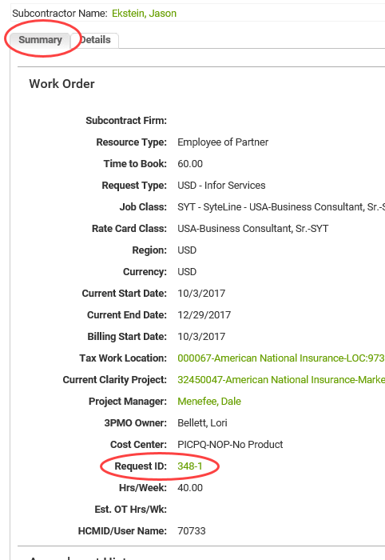
Viewing Work Orders

Slide 62
Managing Work Orders – Extensions & Amendments
Extension: modifies WO start / end dates without modifying WO budget
Amendment: modifies WO budget (e.g., change rates, change # hours)

Slide 63
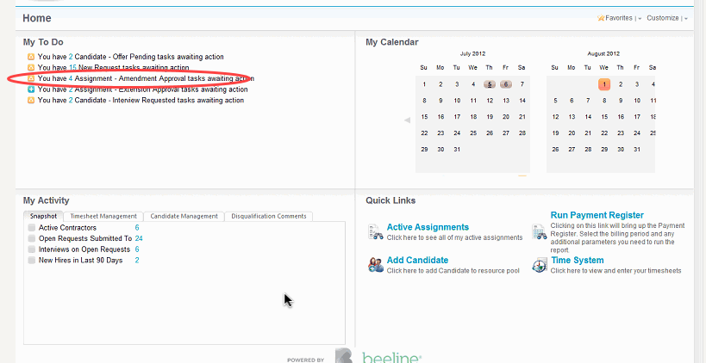
Accept Extension / Amendment

Slide 64
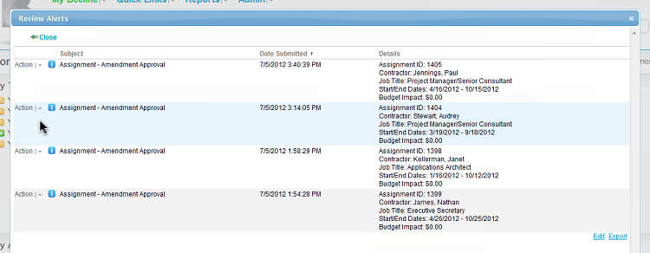
Accept Extension / Amendment

Slide 65
Accept Extension / Amendment
Message acknowledging action
Accepted Amendment removed from list

Slide 66
Accept Extension / Amendment
My To Do item decremented

Slide 67
Time and Expense

Slide 68
Timesheet and Expense Reporting Guidelines
When entering Timesheets and Expenses, all Clarity tasks will be presented for selections. The user must be careful to only select a Labor task for Timesheet entry, or an Expense task for Expenses
Timesheet
Only one Timesheet per Worker per week can be entered.
Includes all hours worked on all projects/all tasks by that Worker during that period.
Expenses
Multiple expense vouchers can be entered for any day, any Work Order, but only for one Work Order. Not time period dependent
Expense vouchers can have multiple items (e.g., airfare, hotel, meal) on one voucher
Weekly Process Schedule
T&E submission by Saturday midnight Eastern time
PM approval by the following Tuesday
Invoice run Thursday, payment per terms

Slide 69
Time and Expenses – Time and Expense Entry

Slide 70
Worker Time / Expense Entry or Editing by Manager/Admin
Select Record Type
Key WO #, let search return results & select
Can also use string search on name

Slide 71
Time and Expense Entry
Top half of Timesheet screen
Toggle between Timesheets and Expenses
Showcase tour recommended for new users
Missing Timesheets (for this Worker)
3 oldest are displayed
Can Display All missing timesheets (for this Worker)
Can scroll to display timesheets for other reporting periods
Timesheet currently being displayed
Save or Submit

Slide 72
Time and Expense Entry
Lower half of Timesheet screen
WO details
Clarity project
All valid Work Orders
for this Worker
for this period
Select Task
Enter Time

Slide 73
Enter Time / Enter Expense - Timesheet
Must pick a non Expense task !!

Slide 74
Enter Time / Enter Expense - Timesheet
Save timesheet
Submit timesheet

Slide 75
Time and Expenses – Expenses

Slide 76
Enter Time / Enter Expense - Create/Edit Expense Voucher
Scroll to previously created voucher
or
Presented with valid WOs, select ‘Create Voucher’

Slide 77
Enter Time / Enter Expense - Edit existing Expense Voucher
Click on pencil icon to edit
Current details appear for editing

Slide 78
Enter Time / Enter Expense - Enter new Expense Voucher
Must re-select correct Project
Then must select Expenses task

Slide 79
Enter Time / Enter Expense - Enter new Expense Voucher
Must pick an Expense task !
“Amount” is in currency of WO
Do any conversions prior to entry
Arnie

Slide 80
Enter Time / Enter Expense - Expenses Adding Attachment
“Amount” is in currency of WO
Do any conversions prior to entry
Arnie

Slide 81
Enter Time / Enter Expense – Expense Details
Arnie
“Description” = vendor + City & State/Province
Arnie’s Diner – Dallas TX

Slide 82
Enter Time / Enter Expense – Expense Details
Depending on the Expense Type different detail fields will appear
Always put provider name and location in ‘Description’
If “Car Mileage” type, you must include “Total Miles”
If hotel, enter room rate and room tax for one day, enter ‘1’ in ‘Nights’ field
Each night is additional entry
Arnie’s Diner – Dallas TX

Slide 83
Enter Time / Enter Expense - Expenses
Arnie’s Diner – Dallas TX

Slide 84
Enter Time / Enter Expense - Expenses
Arnie’s Diner – Dallas TX

Slide 85
Time and Expenses – Time and Expense Admin Functions

Slide 86
Time and Expenses Admin – Timesheet Activity & Missing Timesheets

Slide 87
Time and Expenses Admin – Expense Activity and Pending Approvals

Slide 88
Reports

Slide 89
Infor VMS Reports

Slide 90
Infor VMS Reports
Report Groupings: Favorites, Recent, Recommended, Additional
“Run” – filter predetermined fields
“Create” – report builder

Slide 91
Infor VMS Reports – More/Less/Filtering Selection

Slide 92
Infor VMS Reports – More/Less/Filtering Selection

Slide 93
Infor VMS Reports – Predetermined Fields Example
Timesheet Summary Report

Slide 94
Infor VMS Reports – Output from Predetermined Fields Example
Report output

Slide 95
Infor VMS Reports – Report Builder Example

Slide 96
Infor VMS Reports – Output from Report Builder Example

Slide 97
User Maintenance

Slide 98
Admin Functions Add / Delete Users

Slide 99
Admin Functions Add / Delete Users
For new user
Role = “Partner” or “Partner Admin”
User Type = “Supplier”
Or select existing user record to view/edit

Slide 100
Admin Functions Add / Delete Users

Slide 101
Dale Menefee – Sr. Delivery Partner Manager
Dale.Menefee@Infor.com 440-724-4780
Notes:
Dale is first contact for Suppliers

