Slide 1
Infor Vendor Beeline Instructions
CONFIDENTIAL – INTERNAL USE ONLY, NOT FOR DISTRIBUTION.
October 2020
Copyright © 2020. Infor. All Rights Reserved. Infor.com

Slide 2
Outline
INFOR VENDOR BEELINE INSTRUCTIONS
01
02
03
04
Manage Requests
Manage Resource Pool
Review Requests
Submit Candidates
Manage Interviews
Manage Offers
Decline/Reject Negotiate
Accept
Manage Work Orders
View
Extensions and Amendments
Time and Expenses
Time and Expense Reporting Guidelines
Time and Expense Entry
Time and Expense Admin

Slide 3
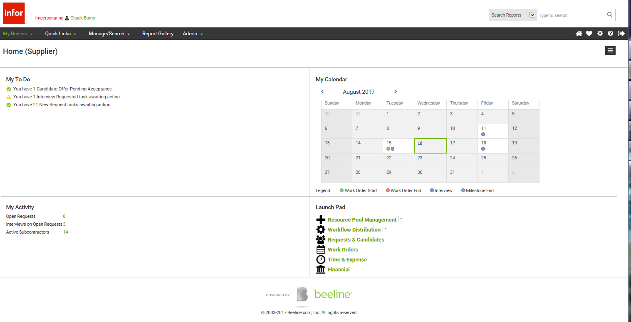
Beeline Dashboard
IINFOR VMS VENDOR BEELINE INSTRUCTIONS
Alerts
Event Calendar
Statuses
Useful links

Slide 4
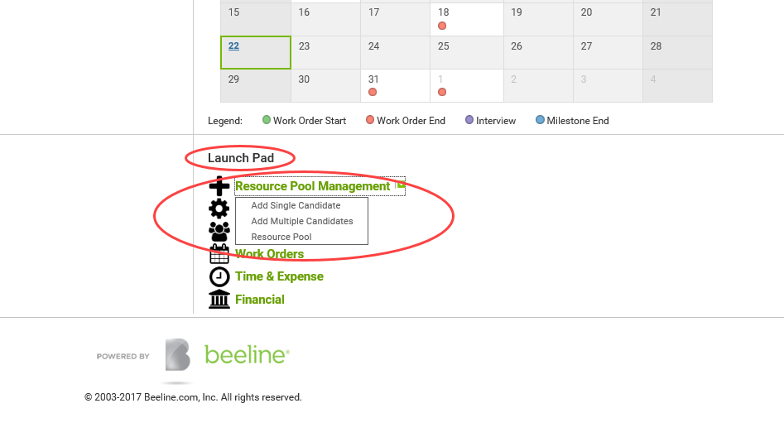
Manage Requests – Manage Resource Pool
IINFOR VMS VENDOR BEELINE INSTRUCTIONS

Slide 5
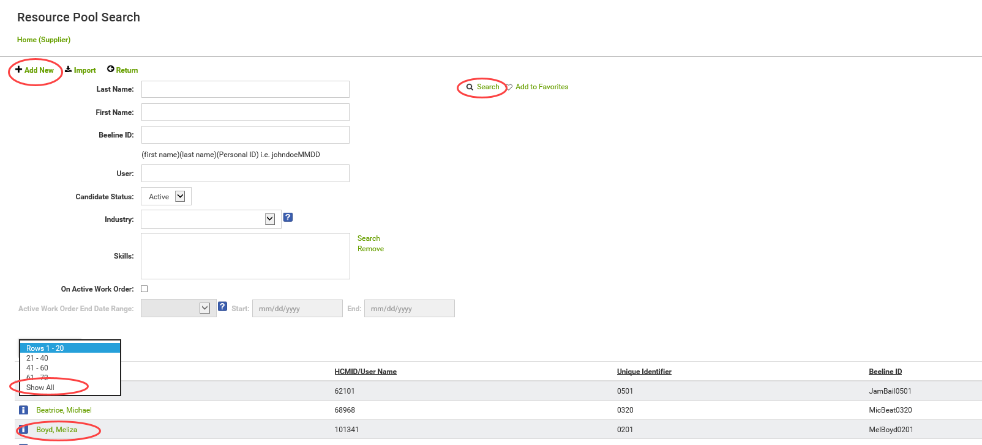
Manage Requests – Resource Pool Search
IINFOR VMS VENDOR BEELINE INSTRUCTIONS
Can Search
Or
View All / Edit

Slide 6
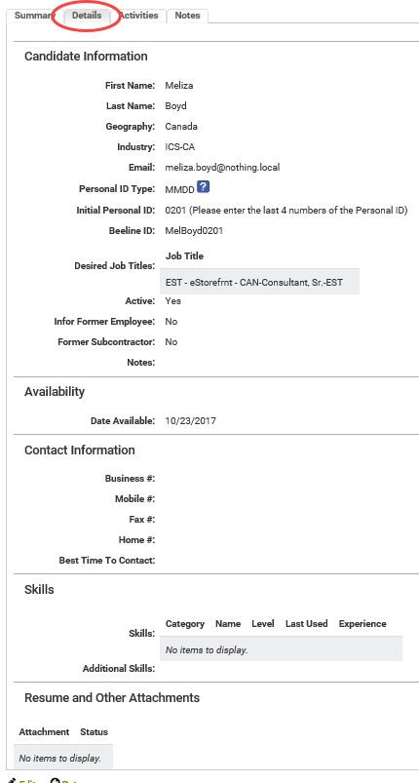
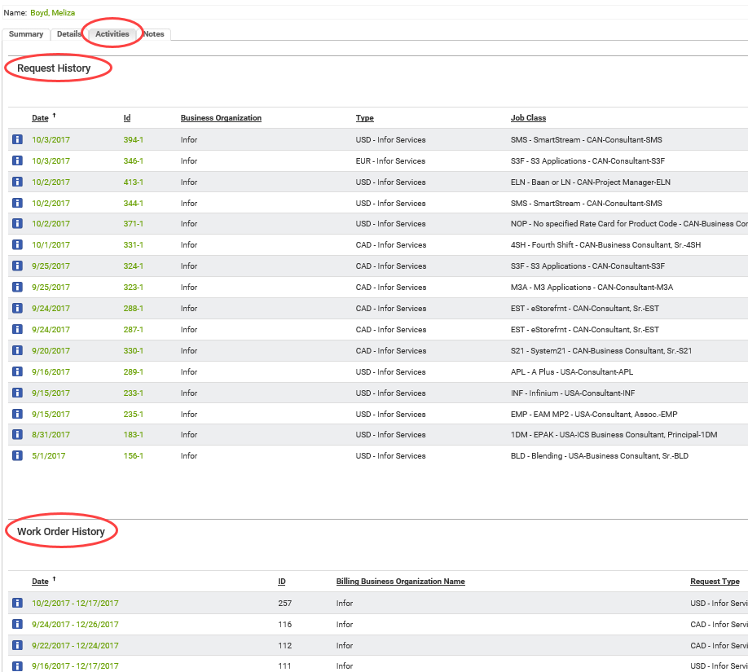
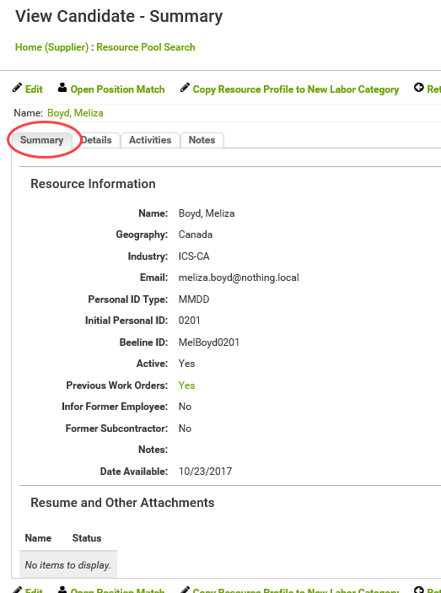
Manage Requests – View/Edit Existing Resource
IINFOR VMS VENDOR BEELINE INSTRUCTIONS

Slide 7
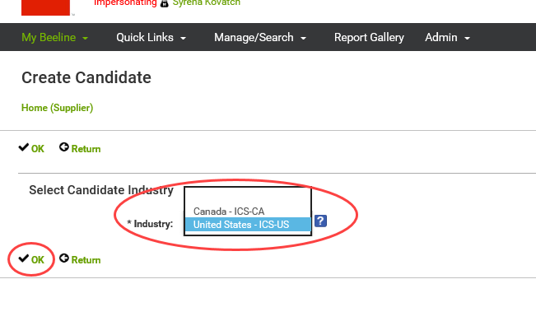
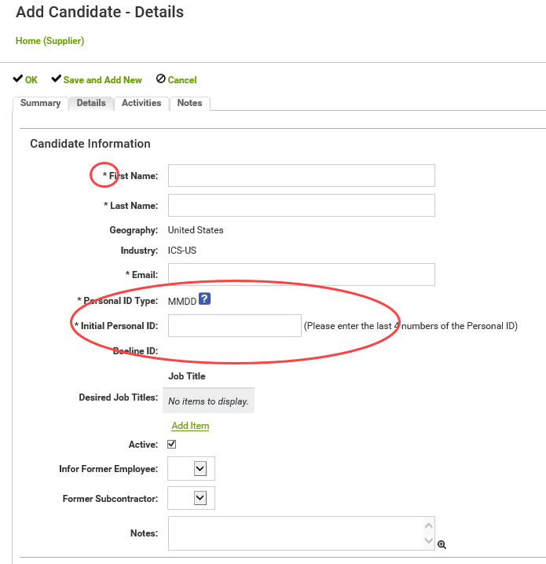
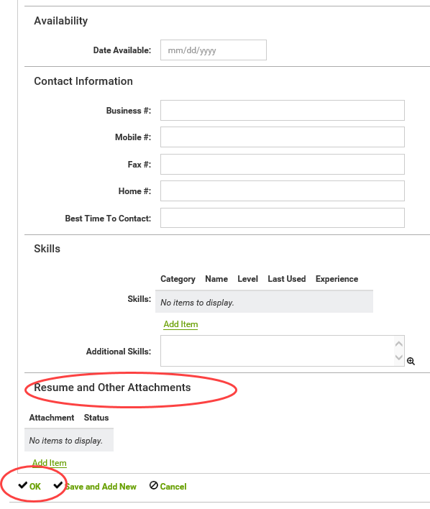
Manage Requests – Add New Resource to Resource Pool
IINFOR VMS VENDOR BEELINE INSTRUCTIONS
Asterisk = Required
Month/day unique identifier

Slide 8
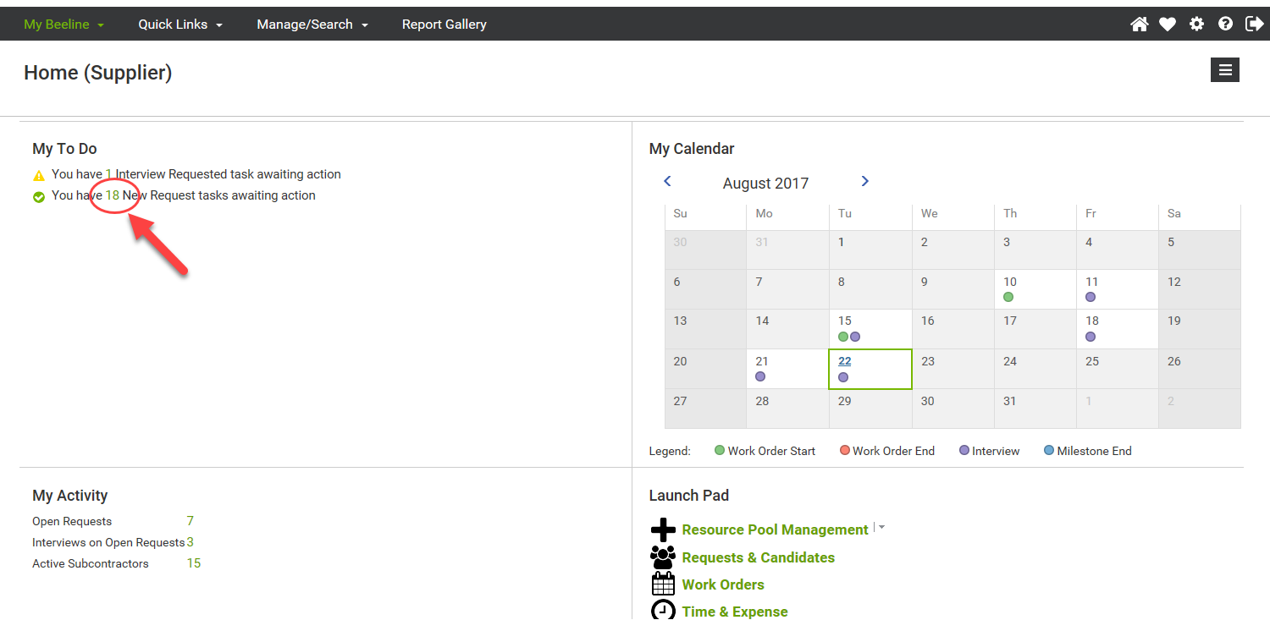
Manage Requests – Review New Request
IINFOR VMS VENDOR BEELINE INSTRUCTIONS
s

Slide 9
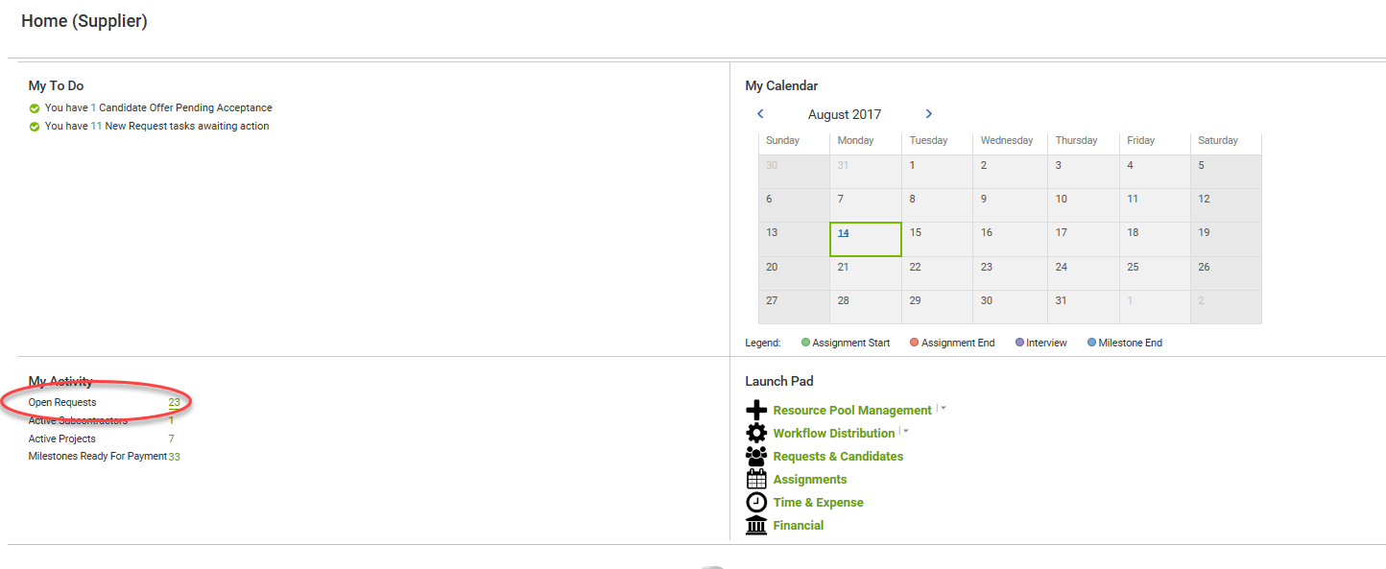
Manage Requests – Review Request In Process
IINFOR VMS VENDOR BEELINE INSTRUCTIONS

Slide 10
Manage Requests – Review Request In Process
IINFOR VMS VENDOR BEELINE INSTRUCTIONS
View open Requests & select one

Slide 11
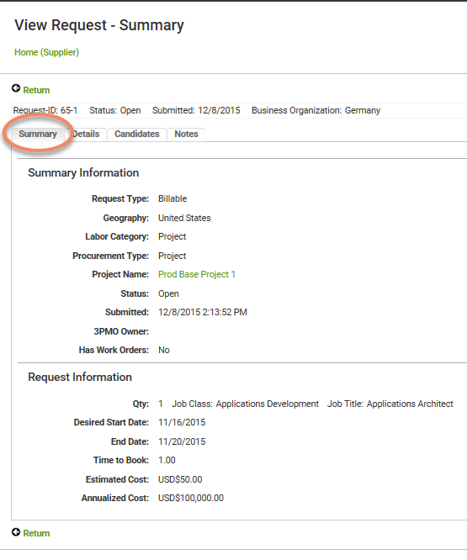
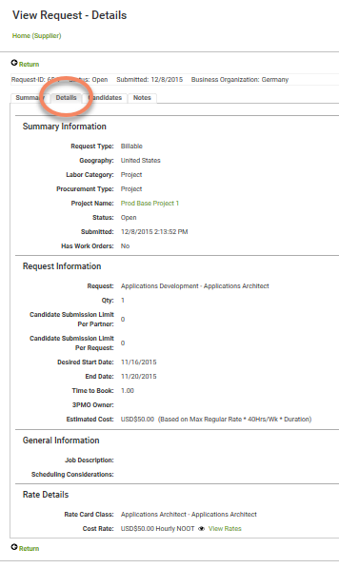
Manage Requests – Review Request in Process
IINFOR VMS VENDOR BEELINE INSTRUCTIONS

Slide 12
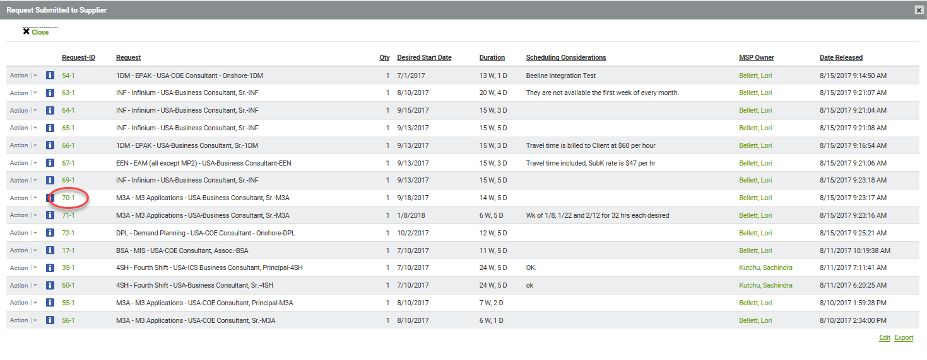
Manage Requests – Decline Submission
IINFOR VMS VENDOR BEELINE INSTRUCTIONS

Slide 13
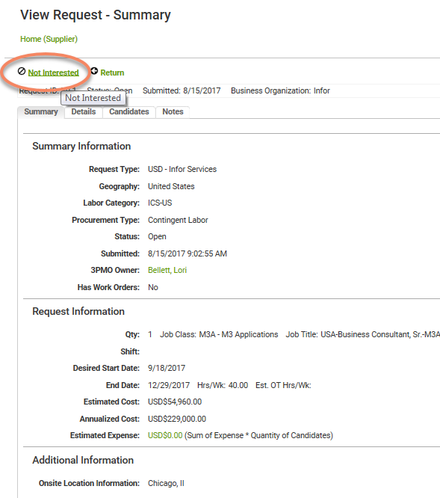
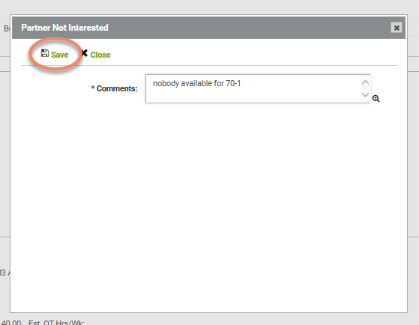
Manage Requests – Decline Submission
IINFOR VMS VENDOR BEELINE INSTRUCTIONS

Slide 14
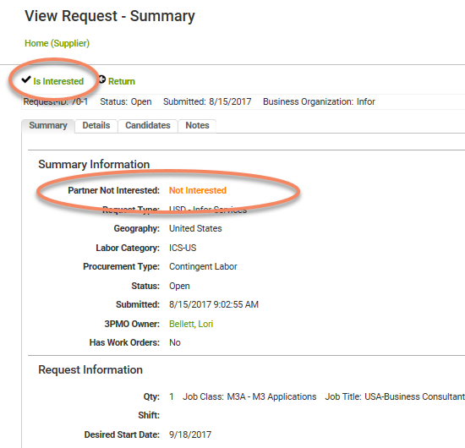
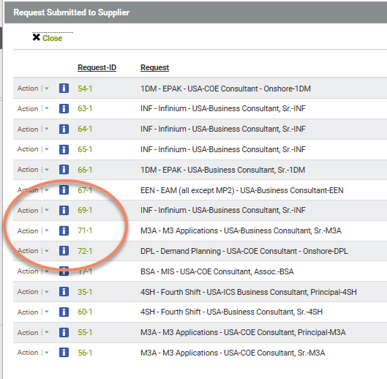
Manage Requests – Decline Submission
IINFOR VMS VENDOR BEELINE INSTRUCTIONS
70-1 no longer in the list

Slide 15
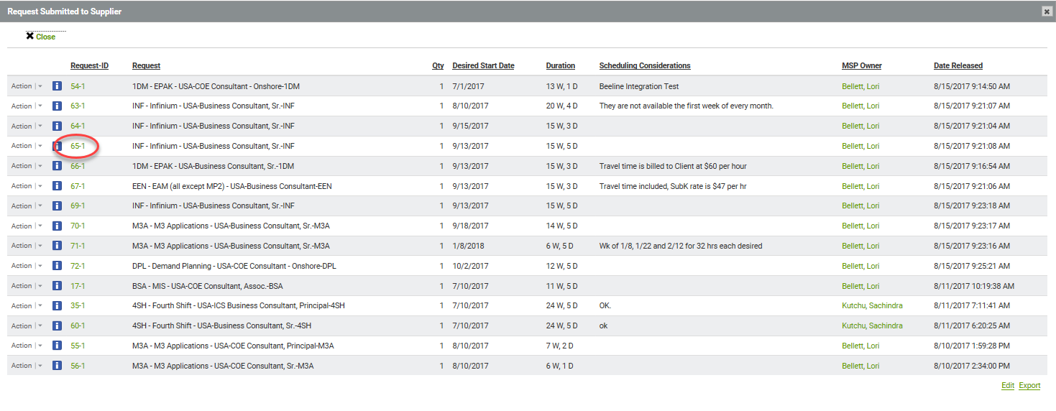
Manage Requests – Propose/Submit Candidates
IINFOR VMS VENDOR BEELINE INSTRUCTIONS

Slide 16
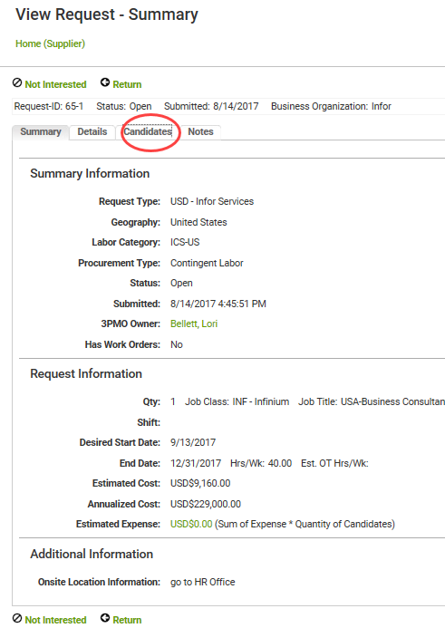
Manage Requests – Propose/Submit Candidates
IINFOR VMS VENDOR BEELINE INSTRUCTIONS

Slide 17
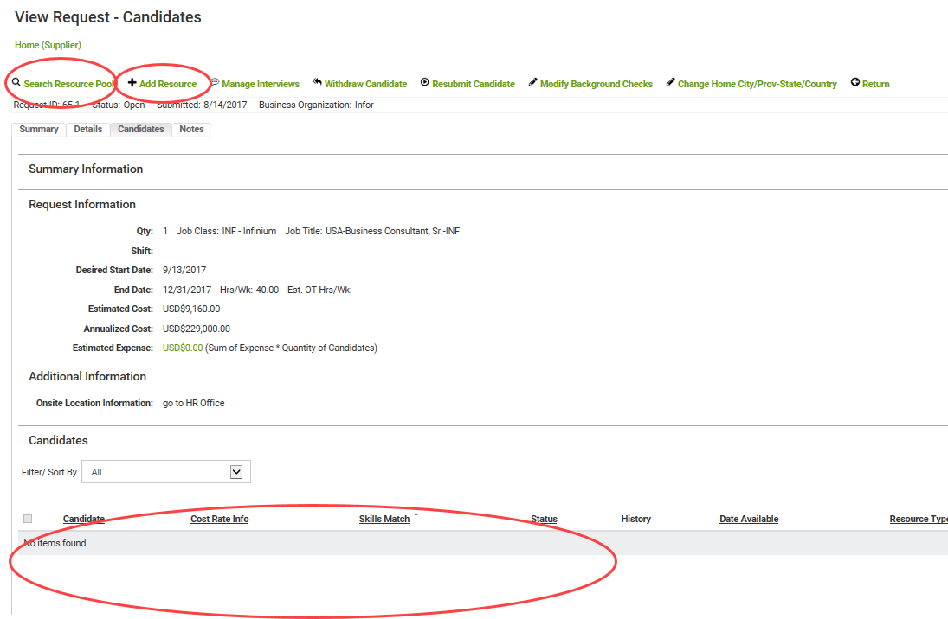
Manage Requests – Propose/Submit Candidates
IINFOR VMS VENDOR BEELINE INSTRUCTIONS
Propose resources from pool
Or
Add a new profile & propose
View of resources already proposed – currently none

Slide 18
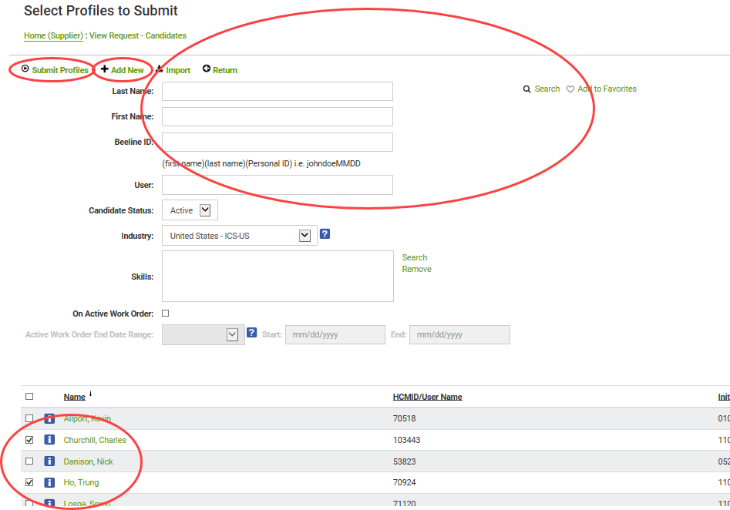
Manage Requests – Propose/Submit Candidates
IINFOR VMS VENDOR BEELINE INSTRUCTIONS
Can add new profile & submit
Can filter list below
With Search
Select profiles & click Submit

Slide 19
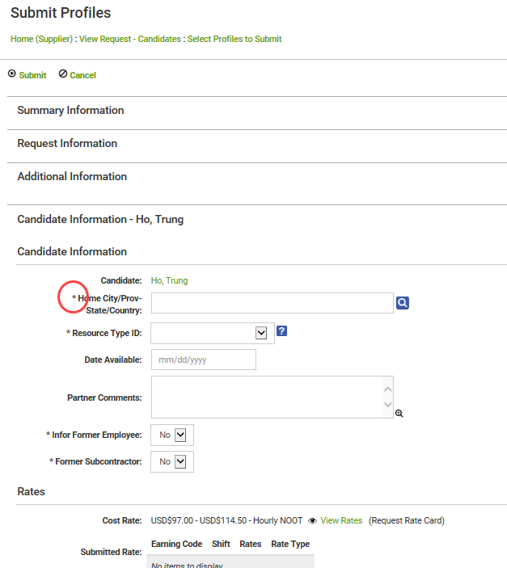
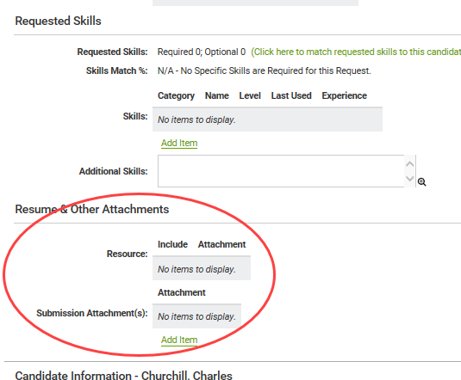
Manage Requests – Propose/Submit Candidates
IINFOR VMS VENDOR BEELINE INSTRUCTIONS
Provide any missing information, add comments, attach resumes, etc
Anything with a red asterisk is required

Slide 20
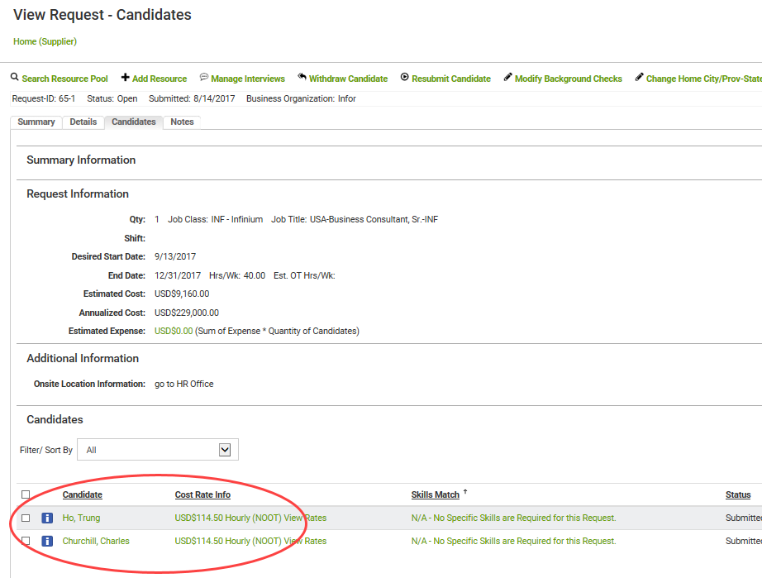
Manage Requests – Propose/Submit Candidates
IINFOR VMS VENDOR BEELINE INSTRUCTIONS
Proposed resources now appear in list

Slide 21
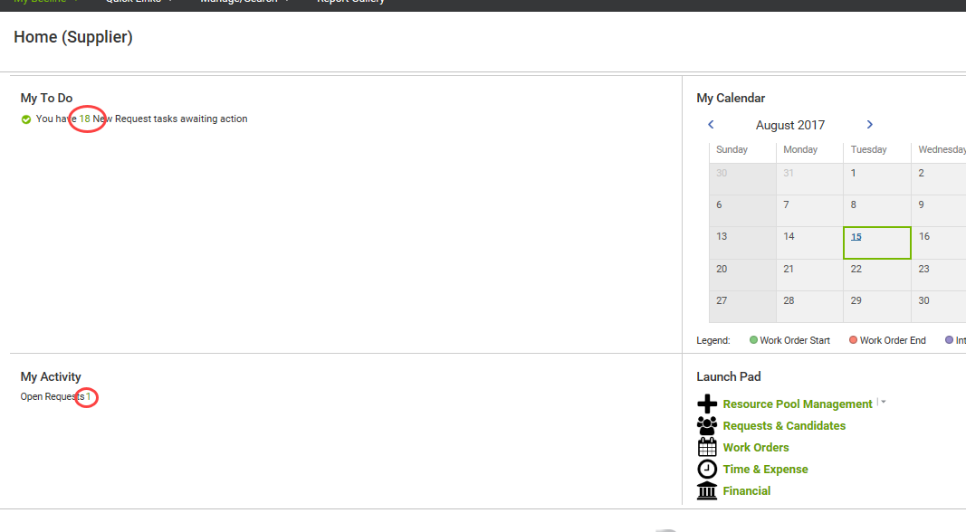
Manage Requests – Propose/Submit Candidates
IINFOR VMS VENDOR BEELINE INSTRUCTIONS
Request has moved from New Requests to Open Requests

Slide 22
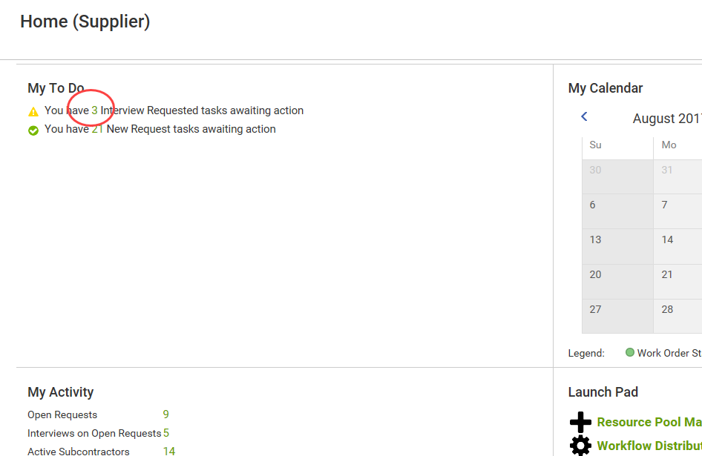
Manage Requests – Accept Interview
IINFOR VMS VENDOR BEELINE INSTRUCTIONS

Slide 23
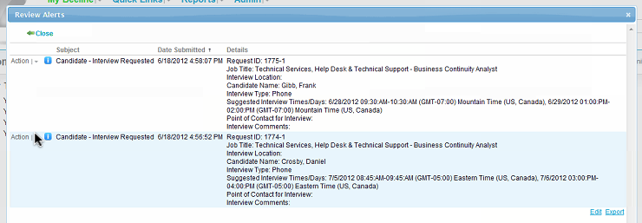
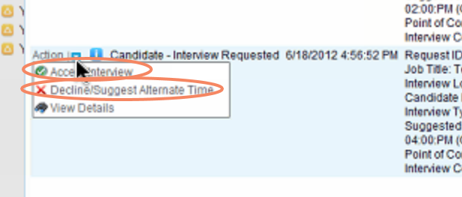
Manage Requests – Accept Interview
IINFOR VMS VENDOR BEELINE INSTRUCTIONS

Slide 24
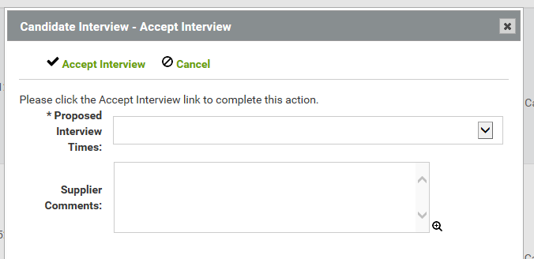
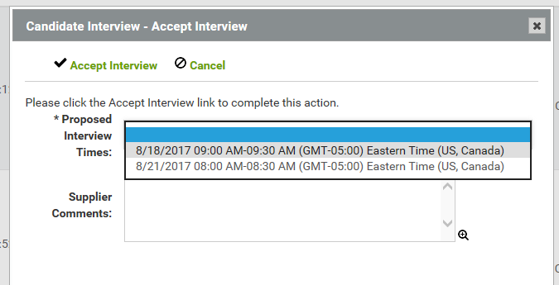
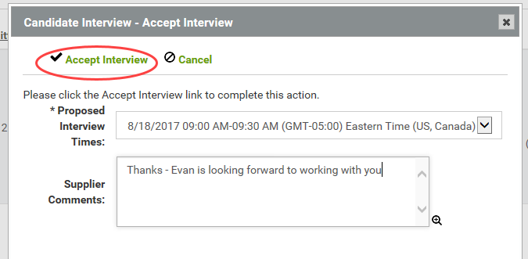
Manage Requests – Accept Interview
IINFOR VMS VENDOR BEELINE INSTRUCTIONS

Slide 25
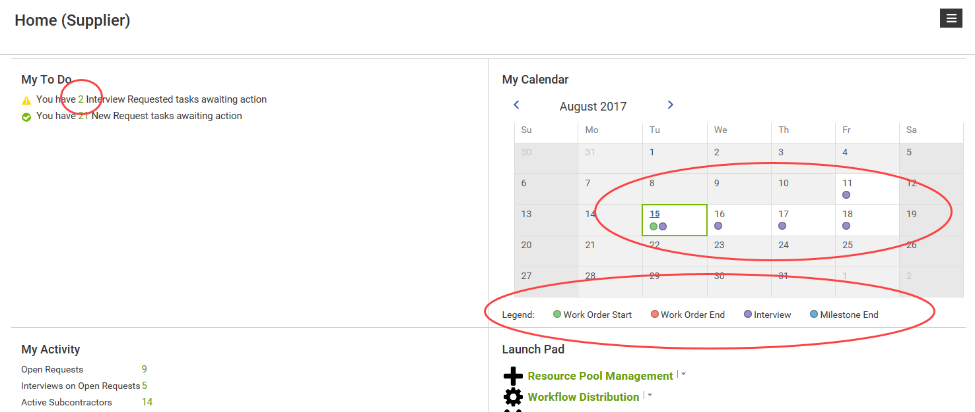
Manage Requests – Accept Interview
IINFOR VMS VENDOR BEELINE INSTRUCTIONS
My Calendar updated
Interview request counter decremented

Slide 26
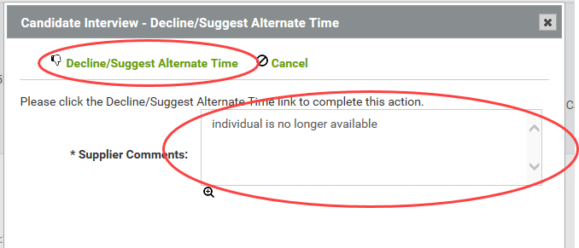
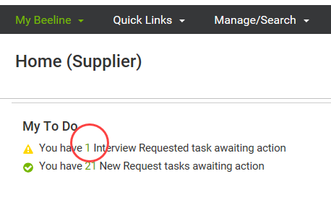
Manage Requests – Decline Interview
IINFOR VMS VENDOR BEELINE INSTRUCTIONS
Interview request counter decremented

Slide 27
Outline
INFOR VENDOR BEELINE INSTRUCTIONS
01
02
03
04
Manage Requests
Manage Resource Pool
Review Requests
Submit Candidates
Manage Interviews
Manage Offers
Decline/Reject Negotiate
Accept
Manage Work Orders
View
Extensions and Amendments
Time and Expenses
Time and Expense Reporting Guidelines
Time and Expense Entry
Time and Expense Admin

Slide 28
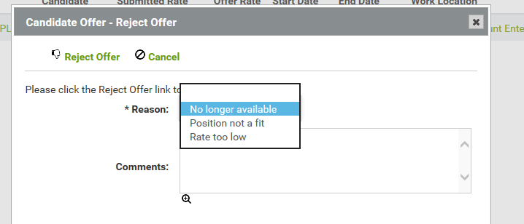
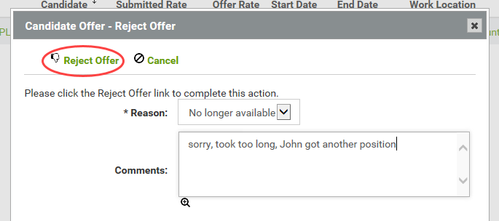
Manage Offers – Decline/Reject Offer
IINFOR VMS VENDOR BEELINE INSTRUCTIONS

Slide 29
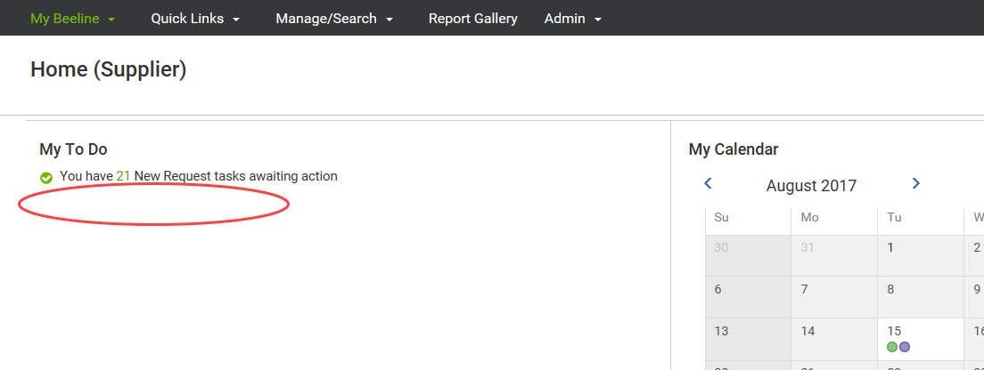
Manage Offers – Decline/Reject Offer
IINFOR VMS VENDOR BEELINE INSTRUCTIONS
Message appears briefly confirming your action, then disappears
Counter is decremented
Since that was the only one, line disappears from My To Do

Slide 30
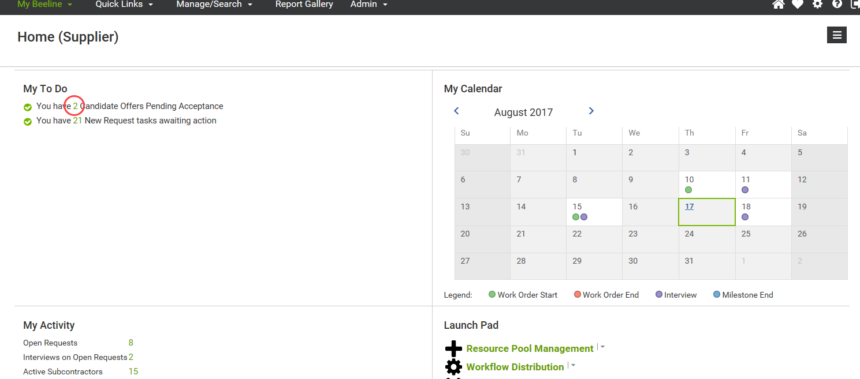
Manage Offers – Accept Offer
IINFOR VMS VENDOR BEELINE INSTRUCTIONS

Slide 31
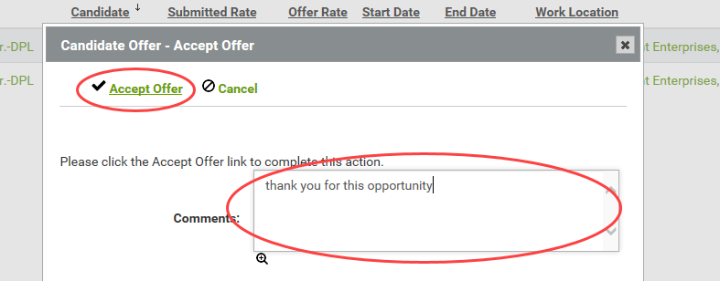
Manage Offers – Accept Offer
IINFOR VMS VENDOR BEELINE INSTRUCTIONS

Slide 32
Manage Offers – Accept Offer
IINFOR VMS VENDOR BEELINE INSTRUCTIONS
Message appears briefly confirming your action, then disappears
Accepted Assignment no longer shown on this screen

Slide 33
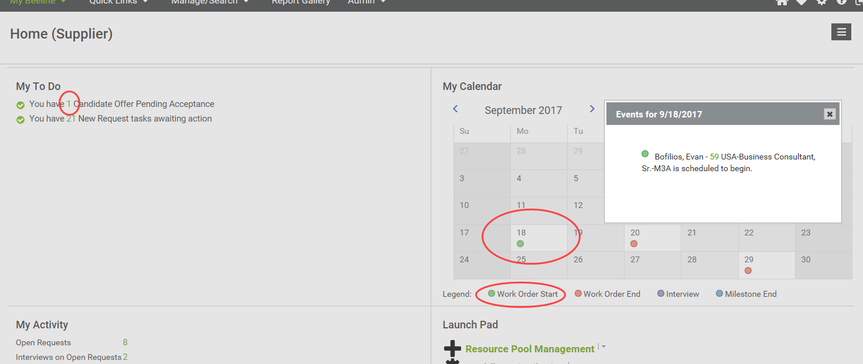
Manage Offers – Accept Offer
IINFOR VMS VENDOR BEELINE INSTRUCTIONS
Counter is decremented
Calendar is updated

Slide 34
Outline
INFOR VENDOR BEELINE INSTRUCTIONS
01
02
03
04
Manage Requests
Manage Resource Pool
Review Requests
Submit Candidates
Manage Interviews
Manage Offers
Decline/Reject Negotiate
Accept
Manage Work Orders
View
Extensions and Amendments
Time and Expenses
Time and Expense Reporting Guidelines
Time and Expense Entry
Time and Expense Admin

Slide 35
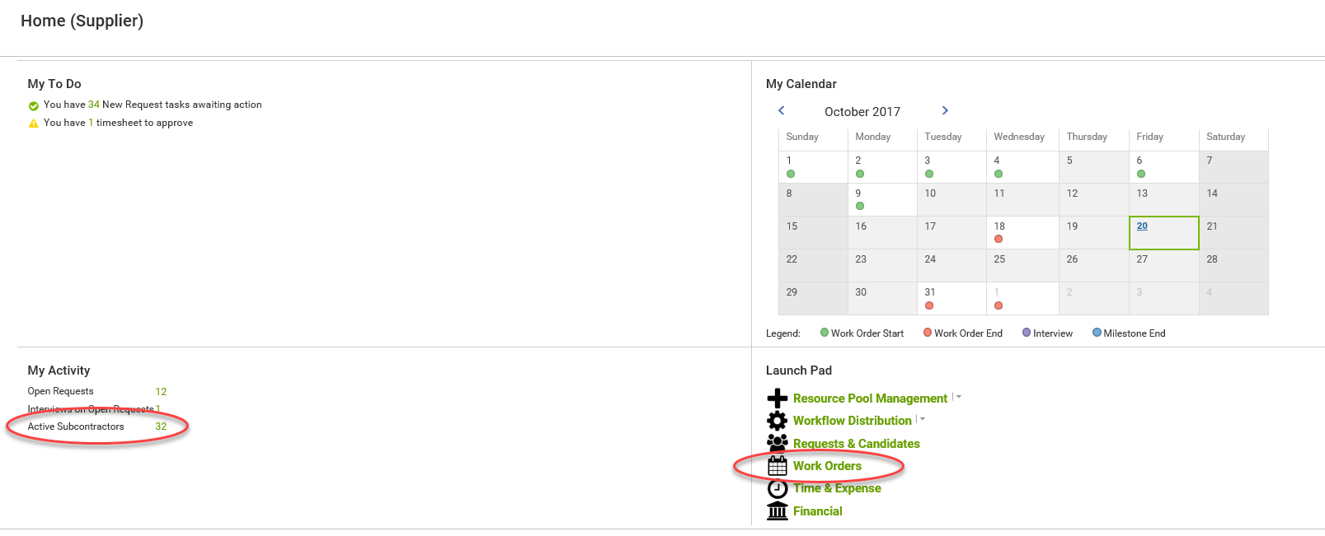
Manage Work Orders – Viewing Work Orders
IINFOR VMS VENDOR BEELINE INSTRUCTIONS
Lists WOs by Worker
Lists WOs
By WO #

Slide 36
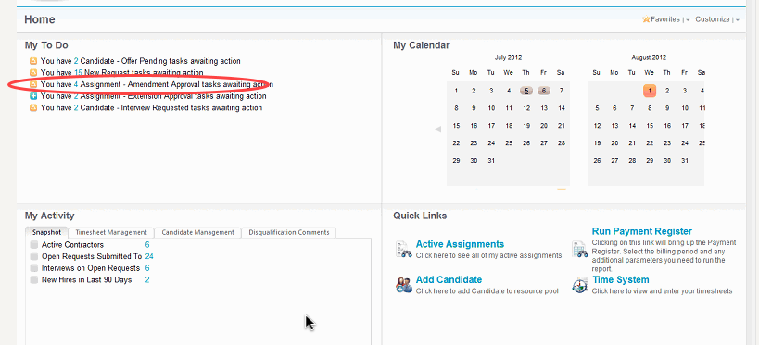
Manage Work Orders – Accept Extension/Amendment
IINFOR VMS VENDOR BEELINE INSTRUCTIONS

Slide 37
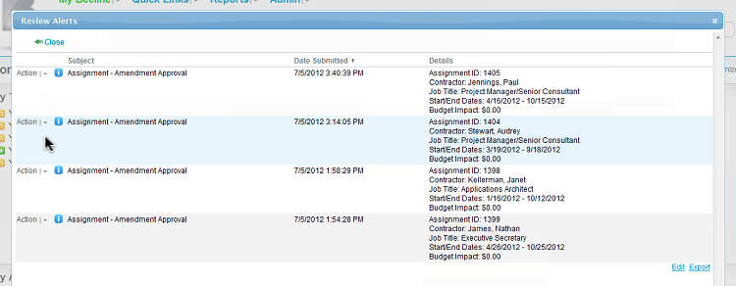
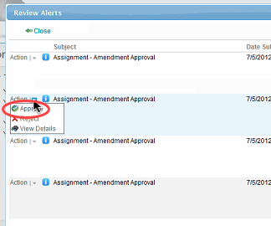
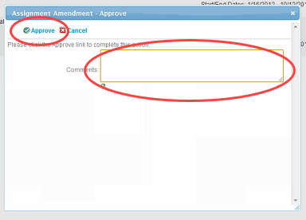
Manage Work Orders – Accept Extension/Amendment
IINFOR VMS VENDOR BEELINE INSTRUCTIONS

Slide 38
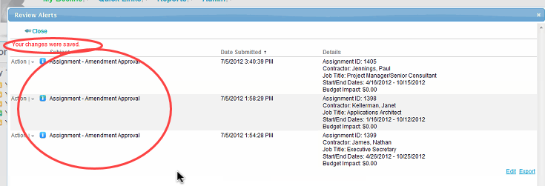
Manage Work Orders – Accept Extension/Amendment
IINFOR VMS VENDOR BEELINE INSTRUCTIONS
Message acknowledging action
Accepted Amendment removed from list

Slide 39
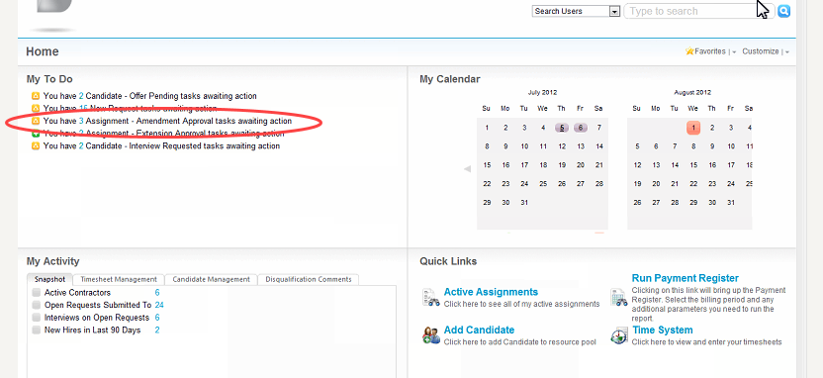
Manage Work Orders – Accept Extension/Amendment
IINFOR VMS VENDOR BEELINE INSTRUCTIONS
My To Do item decremented

Slide 40
Outline
INFOR VENDOR BEELINE INSTRUCTIONS
01
02
03
04
Manage Requests
Manage Resource Pool
Review Requests
Submit Candidates
Manage Interviews
Manage Offers
Decline/Reject Negotiate
Accept
Manage Work Orders
View
Extensions and Amendments
Time and Expenses
Time and Expense Reporting Guidelines
Time and Expense Entry
Time and Expense Admin

Slide 41
Time and Expense – Reporting Guidelines
IINFOR VMS VENDOR BEELINE INSTRUCTIONS
When entering Timesheets and Expenses, all Clarity tasks will be presented for selections. The user must be careful to only select a Labor task for Timesheet entry, or an Expense task for Expenses
Timesheet
Only one timesheet per subcontractor, per week can be entered
Includes all hours worked on all projects/all tasks by that Worker during that period
Expenses
Multiple expense vouchers can be entered for any day, time period dependent
Expense vouchers can have multiple items (e.g., airfare, hotel, meal) on one voucher, but only one work order
Weekly Process Schedule
T&E submission by Saturday
PM approval by the following Tuesday
Invoice run Thursday, payment per terms

Slide 42
Time and Expense – Time Entry
IINFOR VMS VENDOR BEELINE INSTRUCTIONS
Select Record Type
Key WO #, let search return results & select
Can also use string search on name

Slide 43
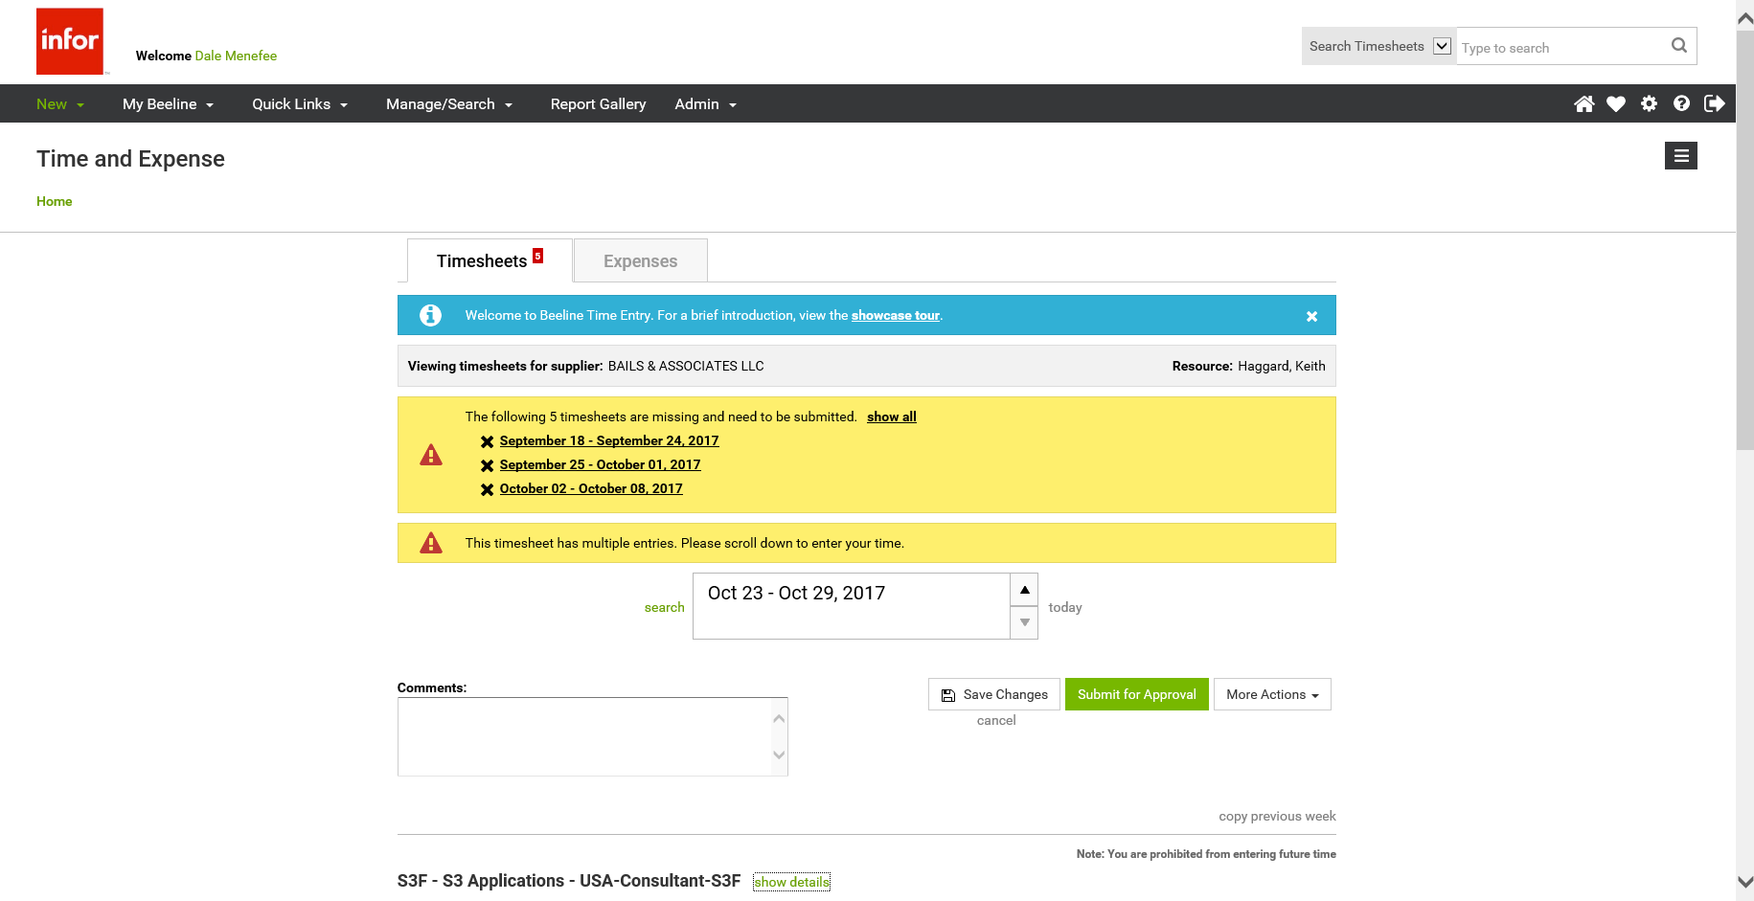
Time and Expense – Time Entry
IINFOR VMS VENDOR BEELINE INSTRUCTIONS
Top half of Timesheet screen
Toggle between Timesheets and Expenses
Showcase tour recommended for new users
Can Display All missing timesheets (for this Worker)
Can scroll to display timesheets for other reporting periods
Timesheet currently being displayed
Save or Submit

Slide 44
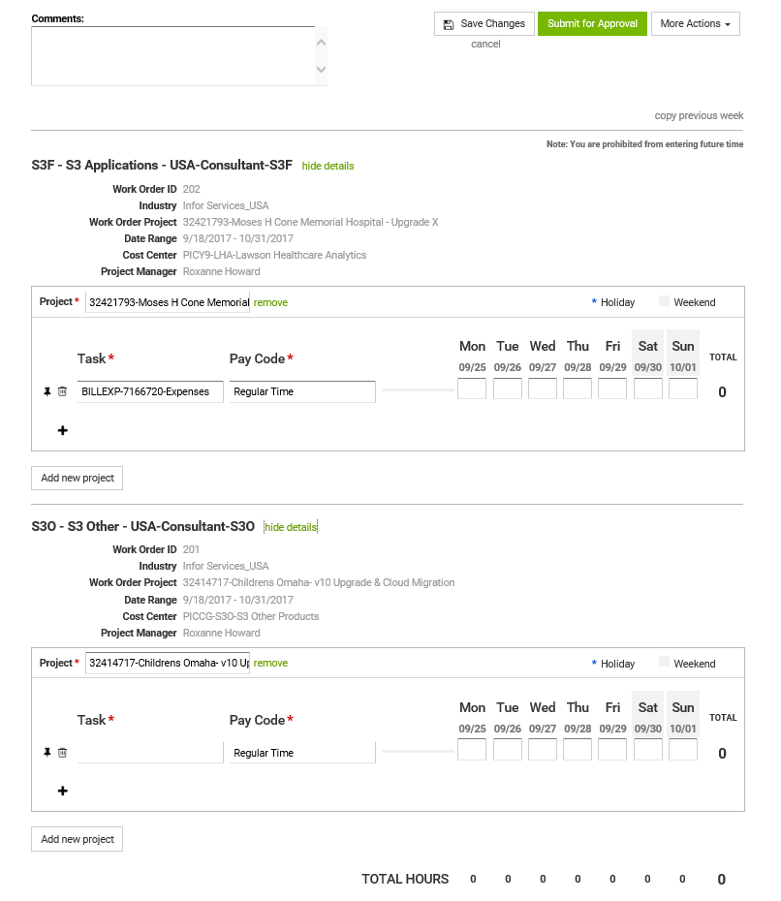
Time and Expense – Time Entry
IINFOR VMS VENDOR BEELINE INSTRUCTIONS
Lower half of Timesheet screen
WO details
Clarity project
All valid Work Orders
for this Worker
for this period
Select Task
Enter Time

Slide 45
Time and Expense – Time Entry
IINFOR VMS VENDOR BEELINE INSTRUCTIONS
Must pick a non Expense task !!

Slide 46
Time and Expense – Time Entry
IINFOR VMS VENDOR BEELINE INSTRUCTIONS
Save timesheet
Submit timesheet

Slide 47
Time and Expense – Expense Entry
IINFOR VMS VENDOR BEELINE INSTRUCTIONS
When entering Expenses, the user must be careful when entering currency and VAT.
Expenses
Enter expenses in the relevant billing currency as shown in VMS on top of the amount field
Convert foreign currency expenses by actual conversion rate from the link below
Domestic costs with domestic VAT – Enter net amount unless contractor is unable to reclaim VAT (e.g. entertaining expenditure)
Foreign costs with foreign VAT – Enter gross cost
https://www.reuters.com/markets/currencies

Slide 48
Time and Expense – Expense Entry
IINFOR VMS VENDOR BEELINE INSTRUCTIONS
Scroll to previously created voucher
or
Presented with valid WOs, select ‘Create Voucher’

Slide 49
Time and Expense – Expense Entry – New
IINFOR VMS VENDOR BEELINE INSTRUCTIONS
Arnie
“Description” = vendor + City & State/Province
Arnie’s Diner – Dallas TX

Slide 50
Time and Expense – Expense Entry – New
IINFOR VMS VENDOR BEELINE INSTRUCTIONS
Depending on the Expense Type different detail fields will appear
Always put provider name and location in ‘Description’
If “Car Mileage” type, you must include “Total Miles”
If hotel, enter room rate and room tax for one day, enter ‘1’ in ‘Nights’ field
Each night is additional entry
Arnie’s Diner – Dallas TX

Slide 51
Time and Expense – Expense Entry – New
IINFOR VMS VENDOR BEELINE INSTRUCTIONS
Arnie’s Diner – Dallas TX

Slide 52
Time and Expense – Expense Entry – New
IINFOR VMS VENDOR BEELINE INSTRUCTIONS
Arnie’s Diner – Dallas TX

Slide 53
Time and Expense – Expense Entry – From Previous
IINFOR VMS VENDOR BEELINE INSTRUCTIONS
Must re-select correct Project
Then must select Expenses task

Slide 54
Time and Expense – Expense Entry – From Previous
IINFOR VMS VENDOR BEELINE INSTRUCTIONS
Must pick an Expense task !
“Amount” is in currency of WO
Do any conversions prior to entry
Arnie

Slide 55
Time and Expense – Expense Entry – From Previous
IINFOR VMS VENDOR BEELINE INSTRUCTIONS
Arnie’s Diner – Dallas TX

Slide 56
Time and Expense – Expense Entry – Attachment
IINFOR VMS VENDOR BEELINE INSTRUCTIONS
“Amount” is in currency of WO
Do any conversions prior to entry
Arnie

Slide 57
Time and Expense – Expense Entry – Edit
IINFOR VMS VENDOR BEELINE INSTRUCTIONS
Click on pencil icon to edit
Current details appear for editing

Slide 58
Time and Expense – Admin Functions
IINFOR VMS VENDOR BEELINE INSTRUCTIONS

Slide 59
Time and Expense – Admin Functions
IINFOR VMS VENDOR BEELINE INSTRUCTIONS

Slide 60
THANK YOU
Infor is a global leader in business cloud software specialized by industry.
infor.com
Copyright © 2020. Infor. All Rights Reserved. Infor.com

